Slide 1
Using dynamic software to explore linear relationships
Graphical representations of linear equations

Slide 2
how to use Oak lessons

Slide 3
I can solve a range of problems involving graphical and algebraic aspects of linear relationships using dynamic software.

Slide 4
The gradient is a measure of how steep a line is. It is calculated by finding the rate of change in the y-direction with respect to the positive x-direction.
An intercept is the coordinate where a line or curve meets a given axis.

Slide 5

Using dynamic software to explore linear relationships
Changing the gradient
Changing the y-intercept

Slide 6
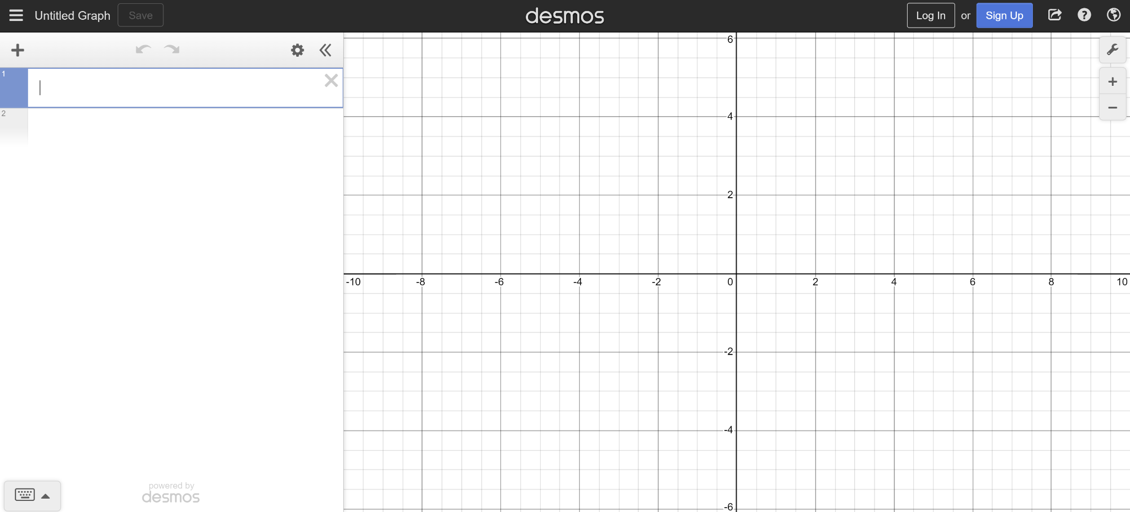
Changing the gradient
To get started:
Open up a web browser and go to desmos.com
Find and press the ‘graphing calculator’ button
Your screen should look like this

Slide 7
Changing the gradient
Click on the ‘graph settings’ menu and update your axes labels and steps

Slide 8
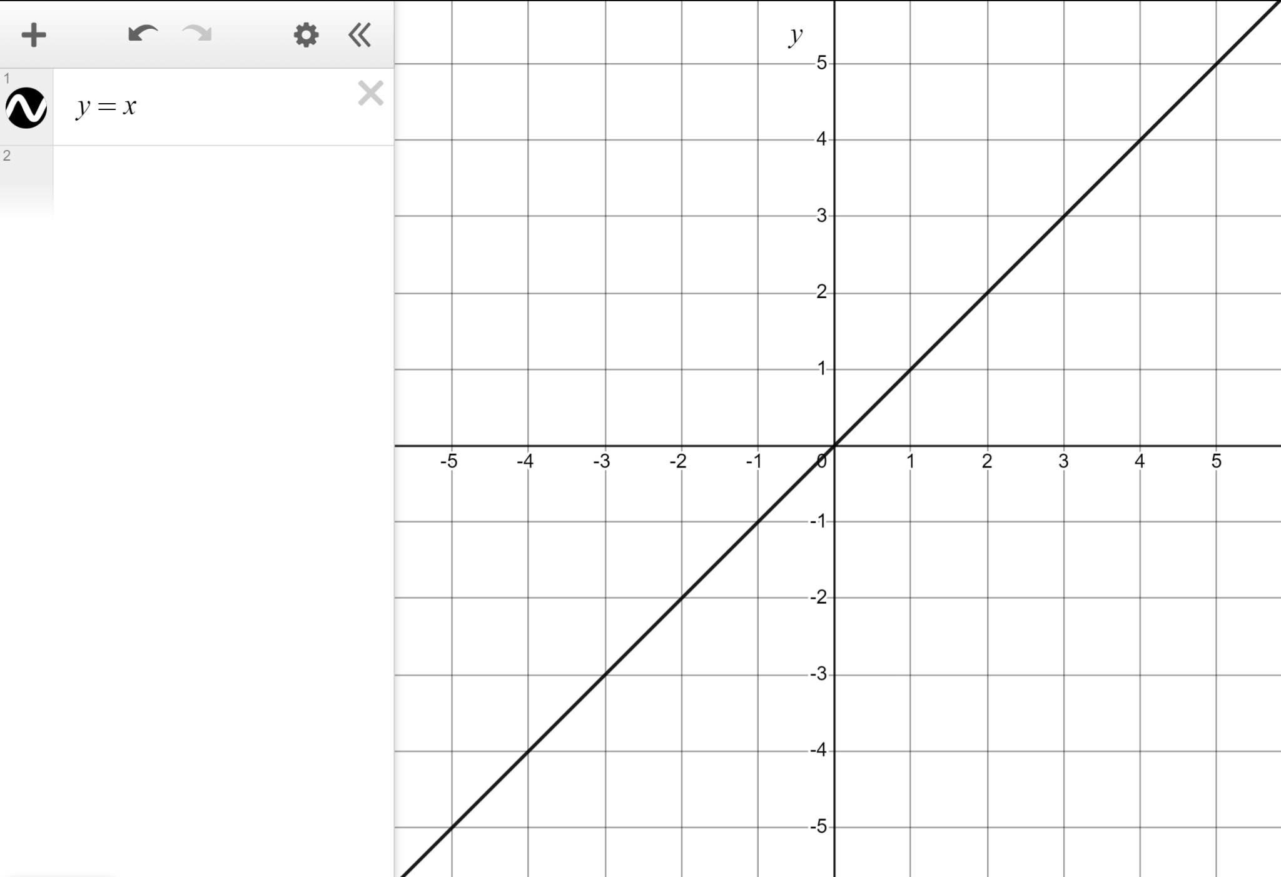
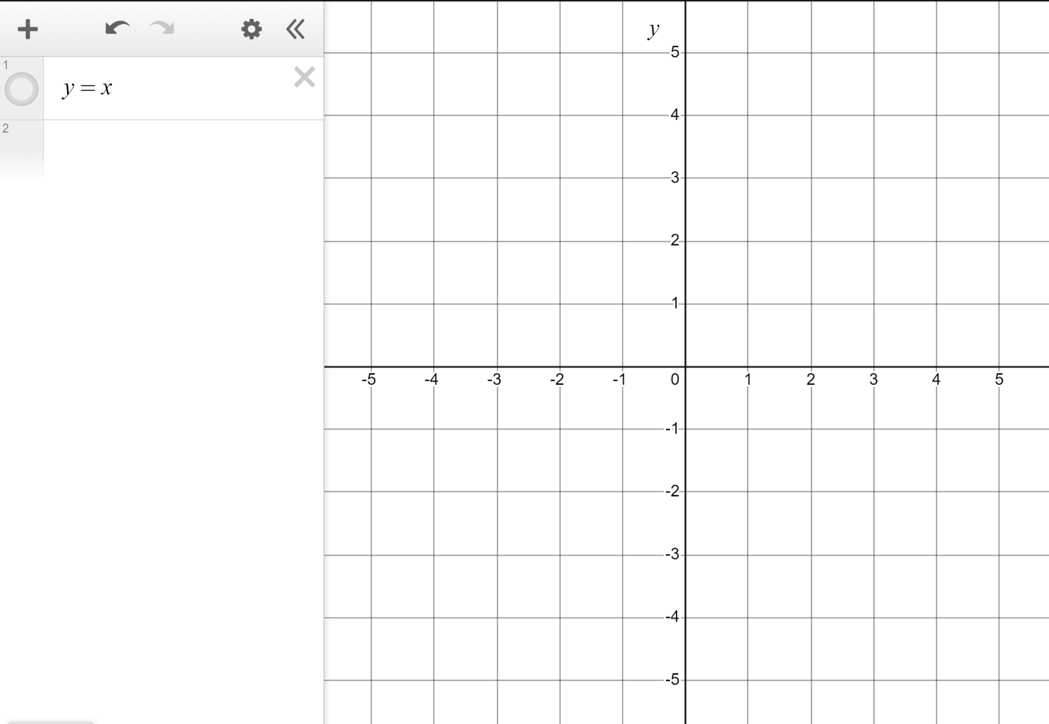
Changing the gradient
We’re now ready to explore linear relationships.
Zoom and drag so your screen is scaled like this, with −5 to +5 visible on both axes.
Type y = x in here.
The line y = x
A gradient of 1, intercepting the y-axis at the origin.

Slide 9
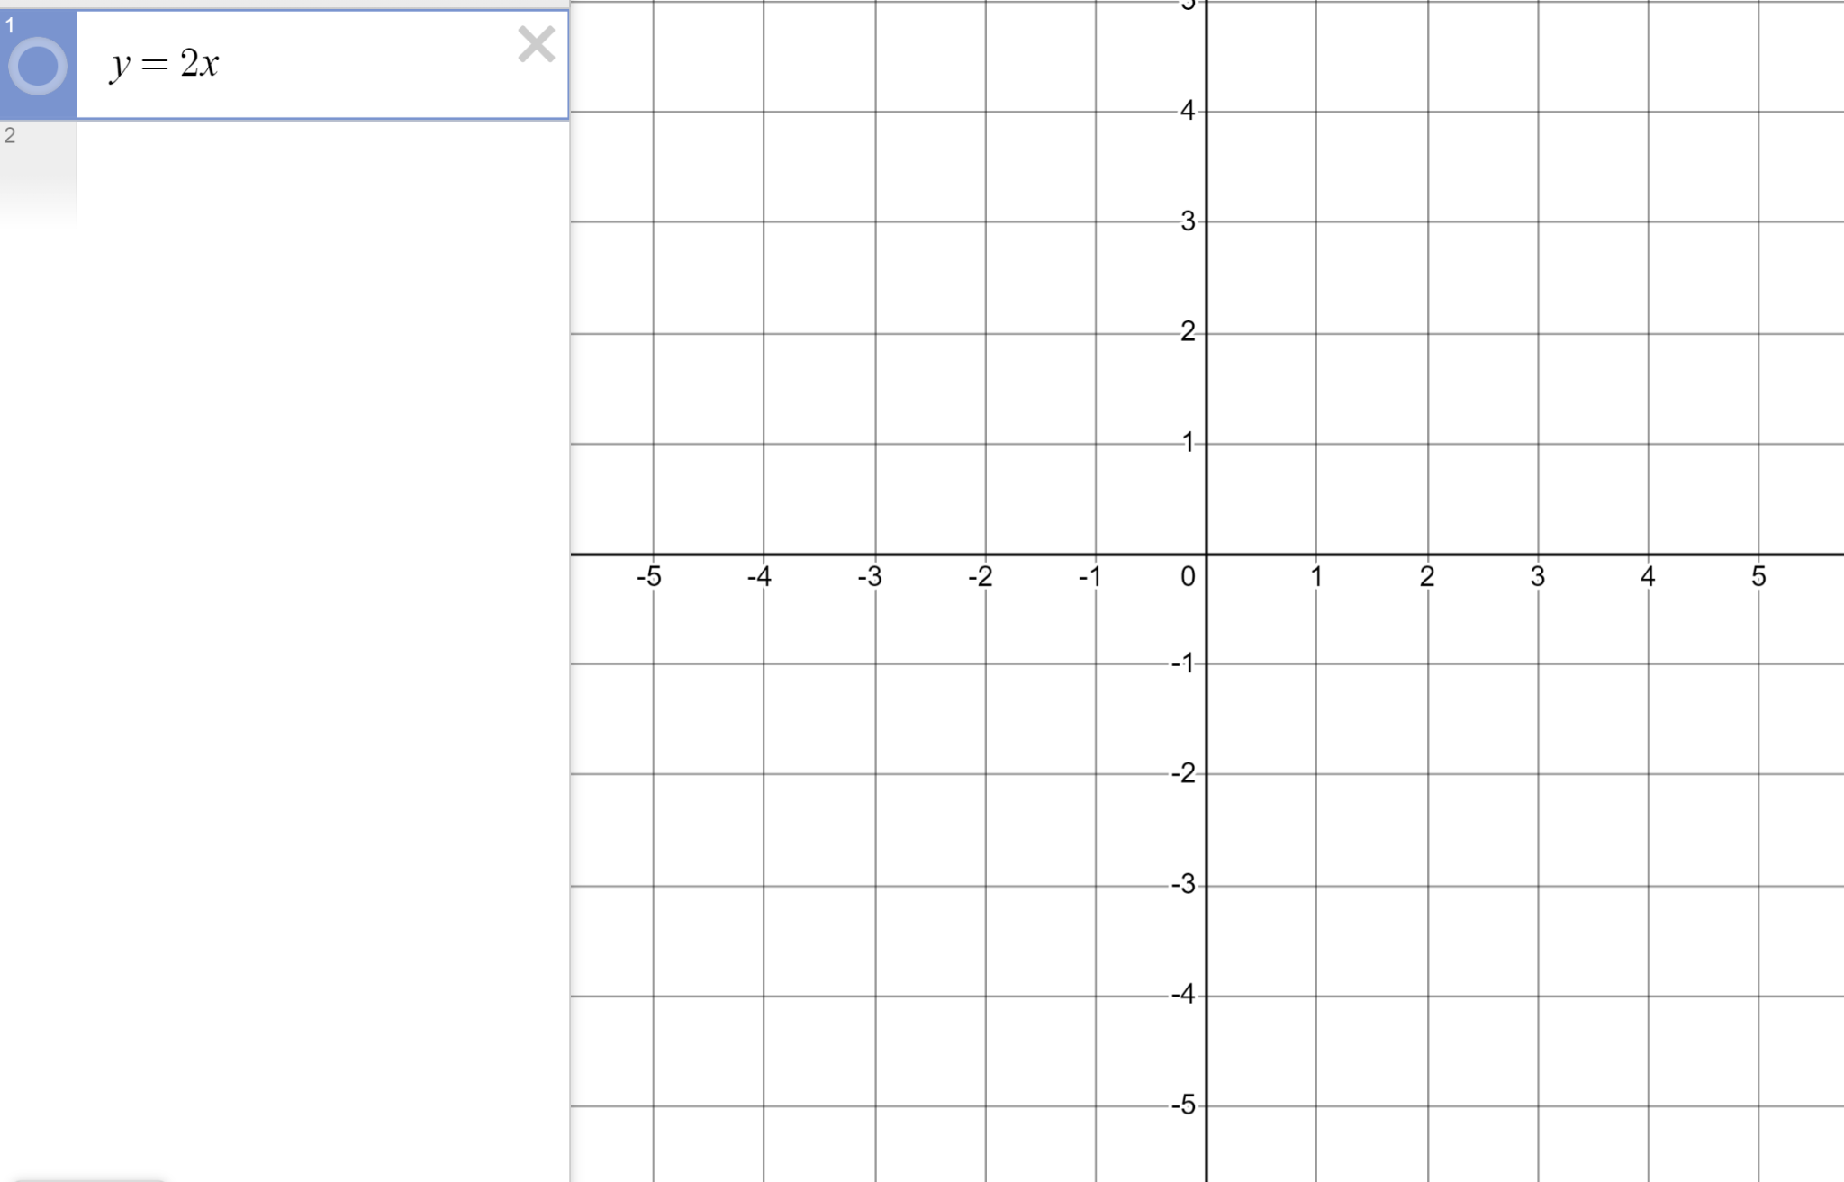
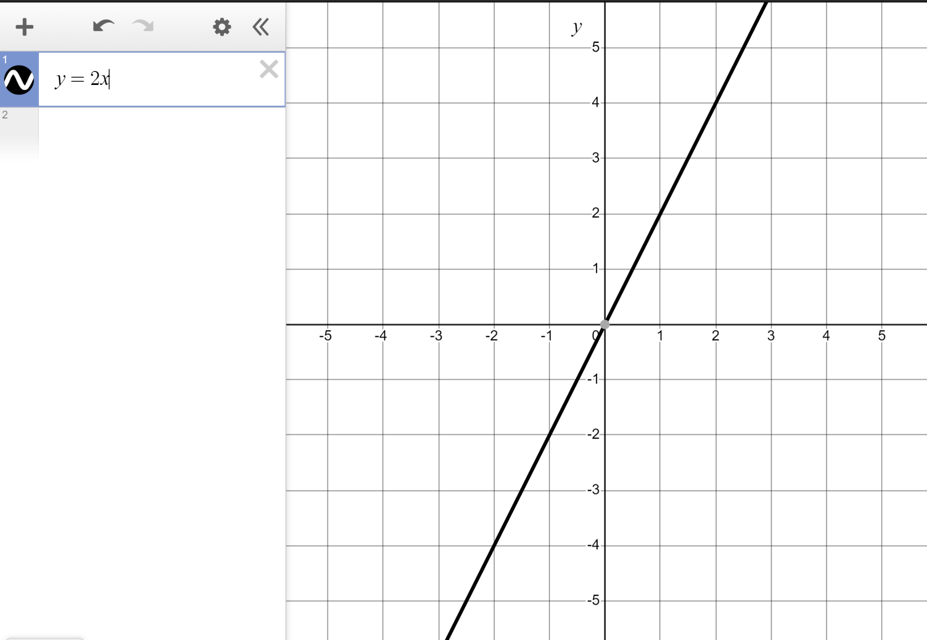
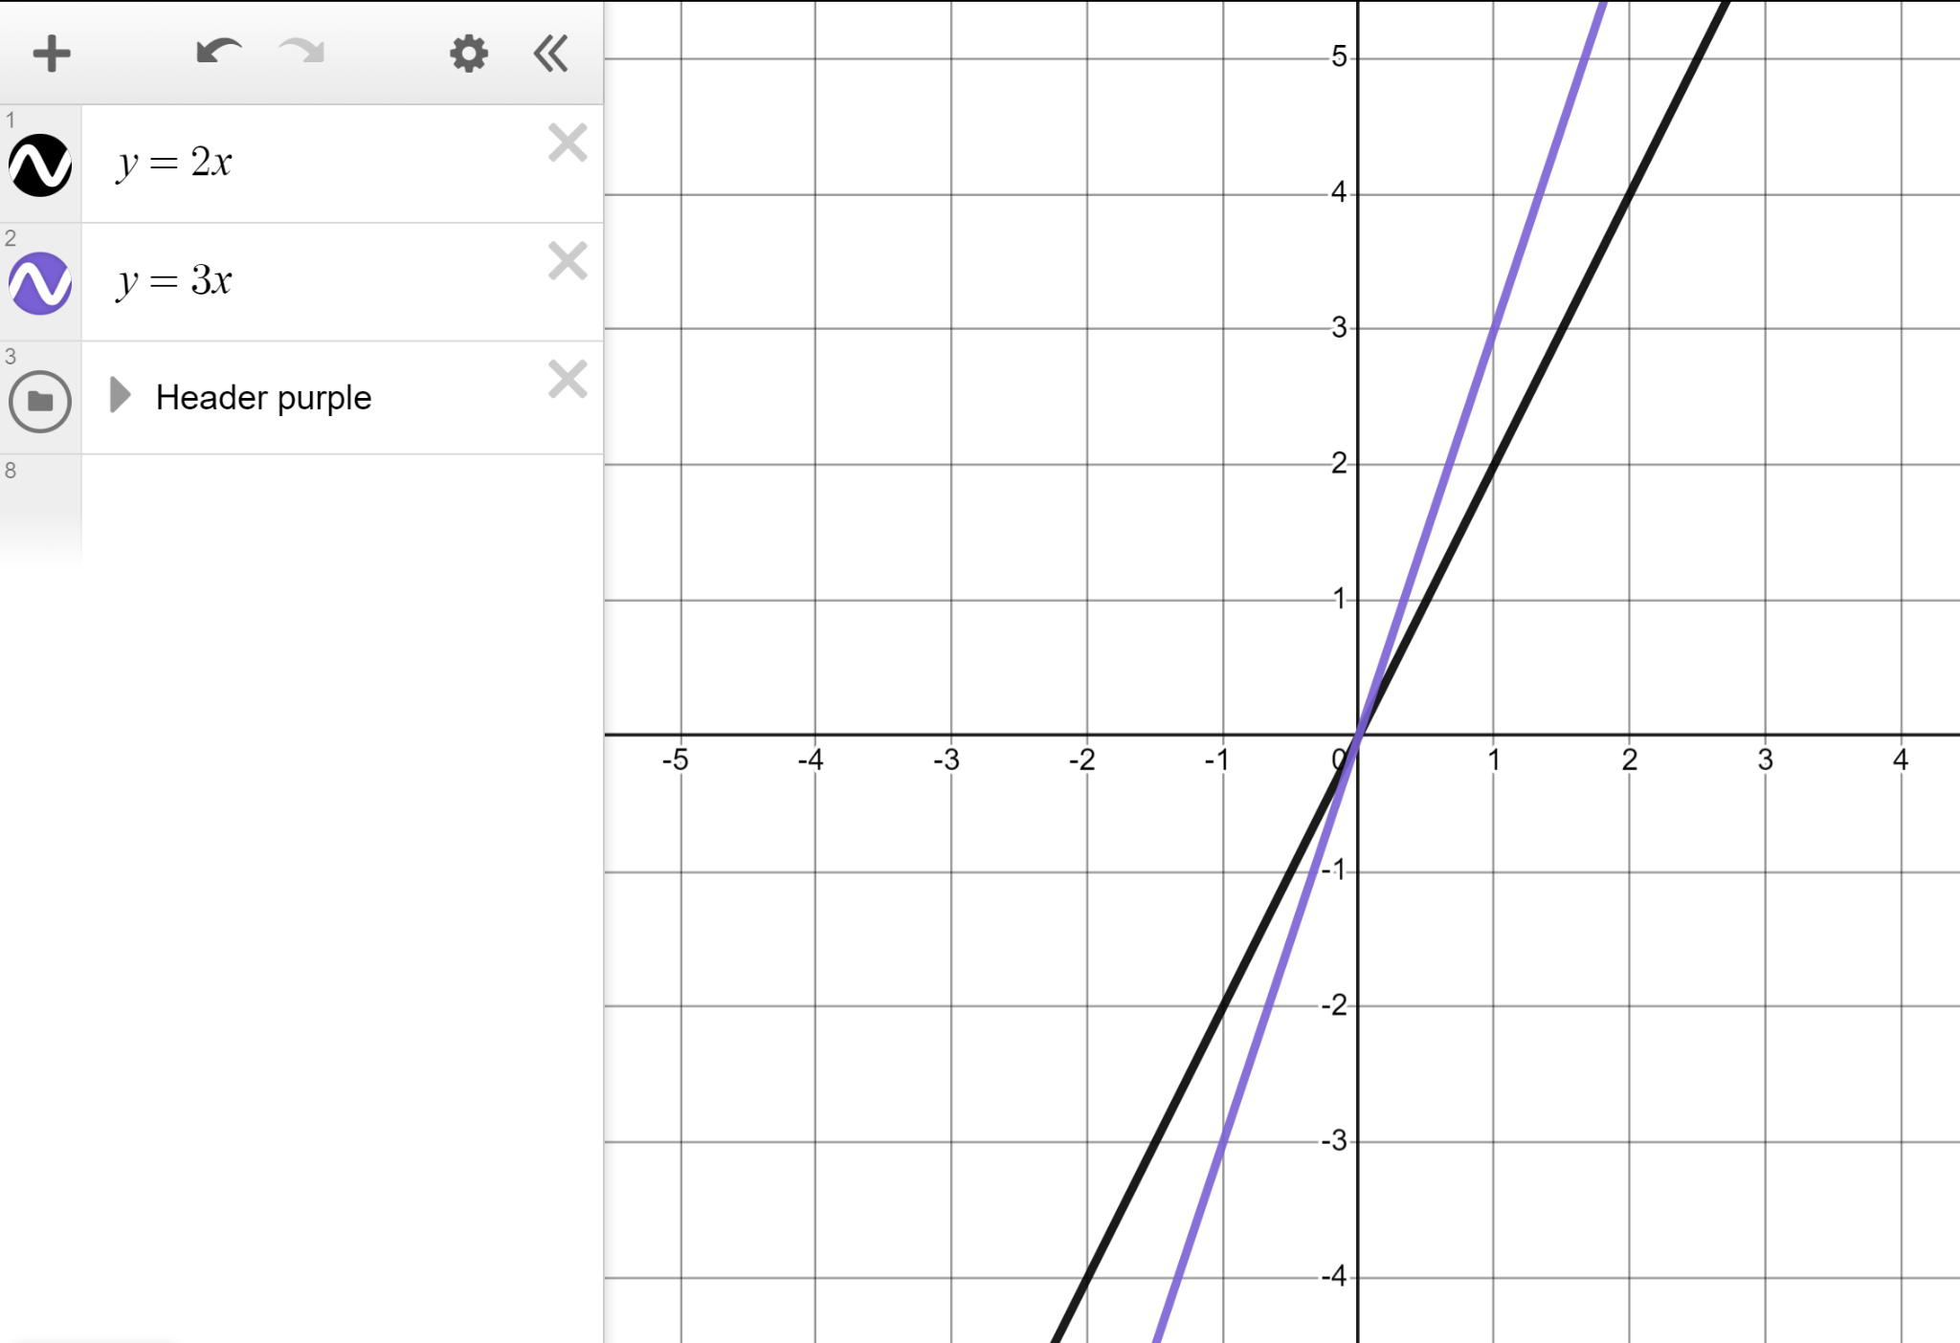
Changing the gradient
Change it to y = 2x
The line y = 2x
Gradient of 2, intercepting the y-axis at the origin.
Type y = 3x below
The line y = 3x
Gradient of 3, intercepting the y-axis at the origin.

Slide 10
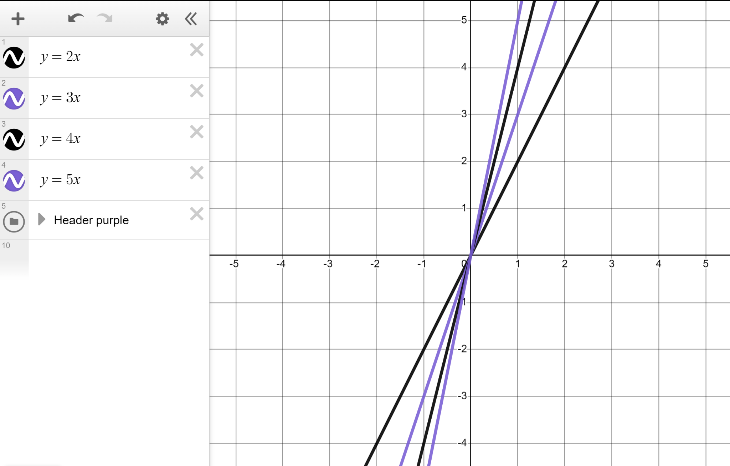
Changing the gradient
You should have the lines y = 2x and y = 3x drawn.
Add the lines y = 4x and y = 5x and compare the four lines.
You might have said:
All four lines share the same y‐intercept of (0, 0)
The lines have different gradients of 2, 3, 4, and 5 respectively.

Slide 11
Changing the gradient
Let’s delete the lines y = 2x, y = 3x, y = 4x, y = 5x. We can use a slider to play with different values of the gradient for the equation y = mx

Slide 12
Changing the gradient
We can study the changing gradient more closely by changing the bounds and steps for the slider.

Slide 13
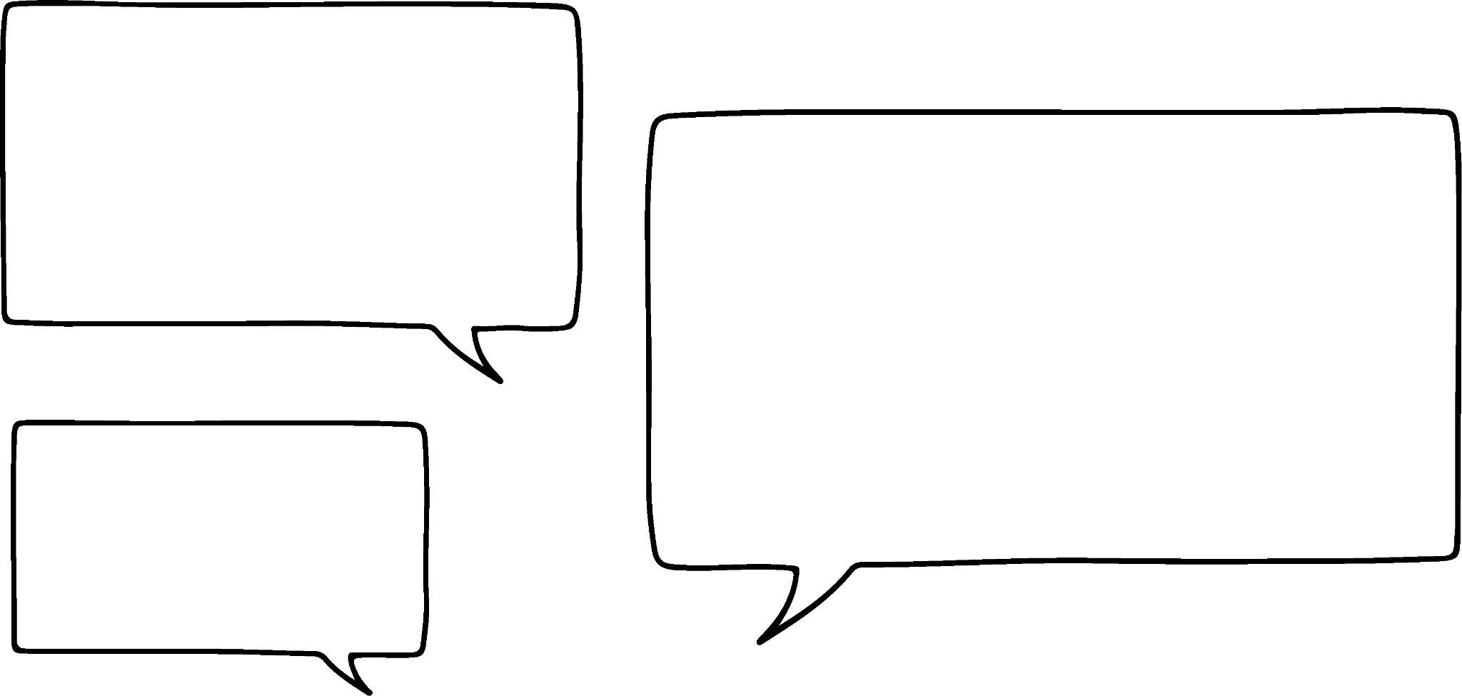



Changing the gradient
What does y = 2x mean?
A straight line with a gradient of 2
The y-coordinate is double the x-coordinate.
For every change of +1 in x there is a change of +2 in y
Lucas
Laura
Sam
Who is right?
They all are! They are just thinking about it differently.

Slide 14
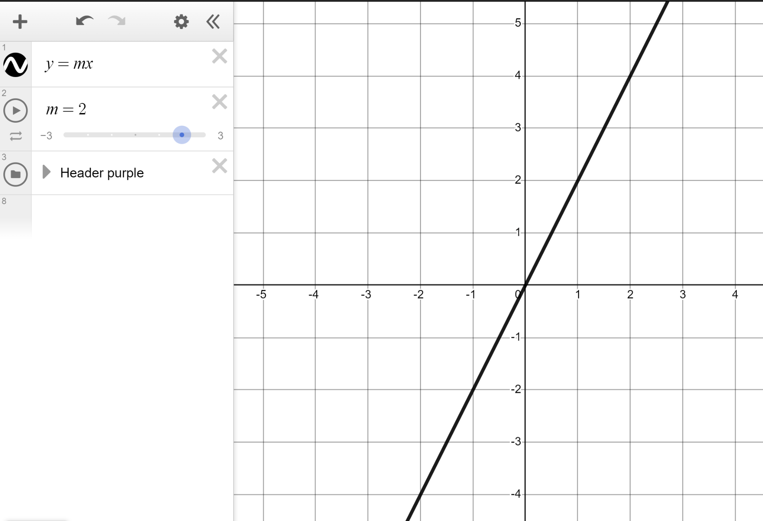
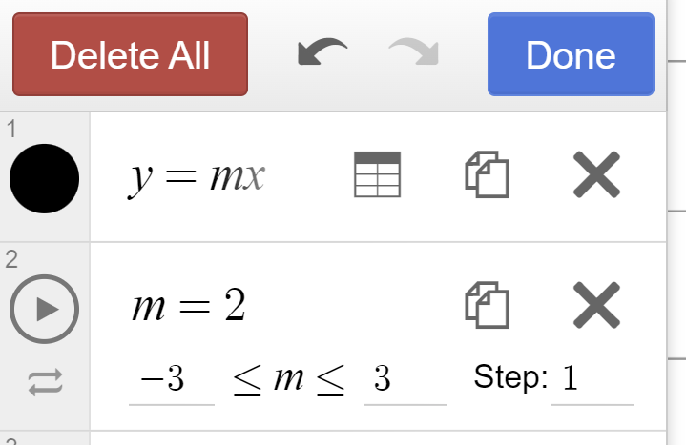
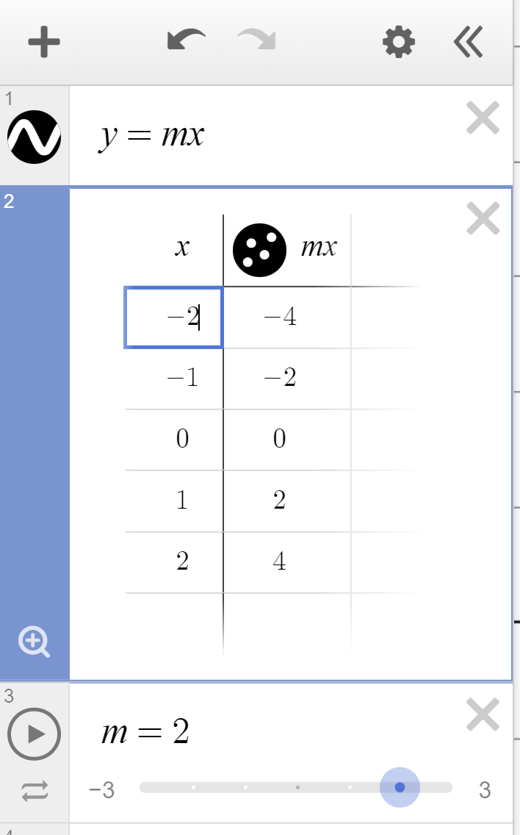
Changing the gradient
Press the ‘edit list’ icon.
Click on ‘table’.
Press and hold here to change your coordinates to crosses and resize them.

Slide 15
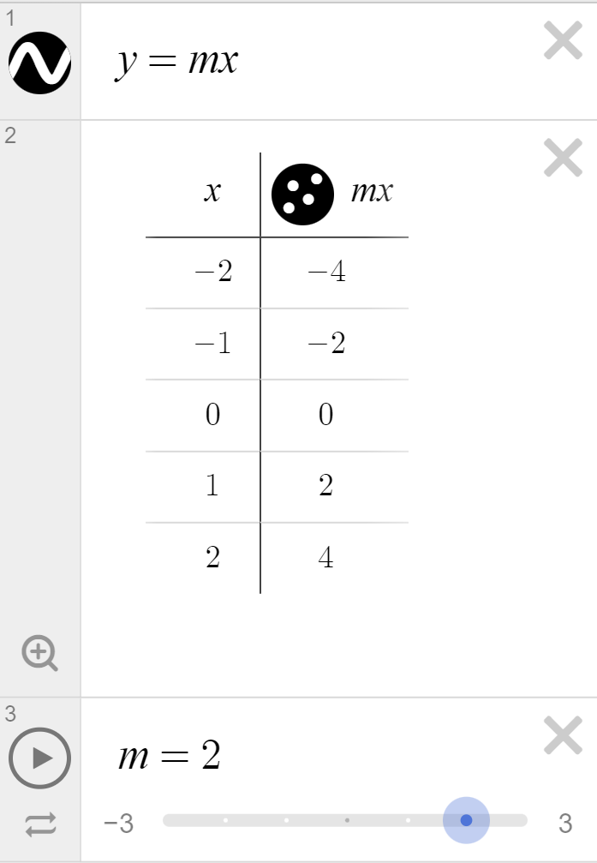
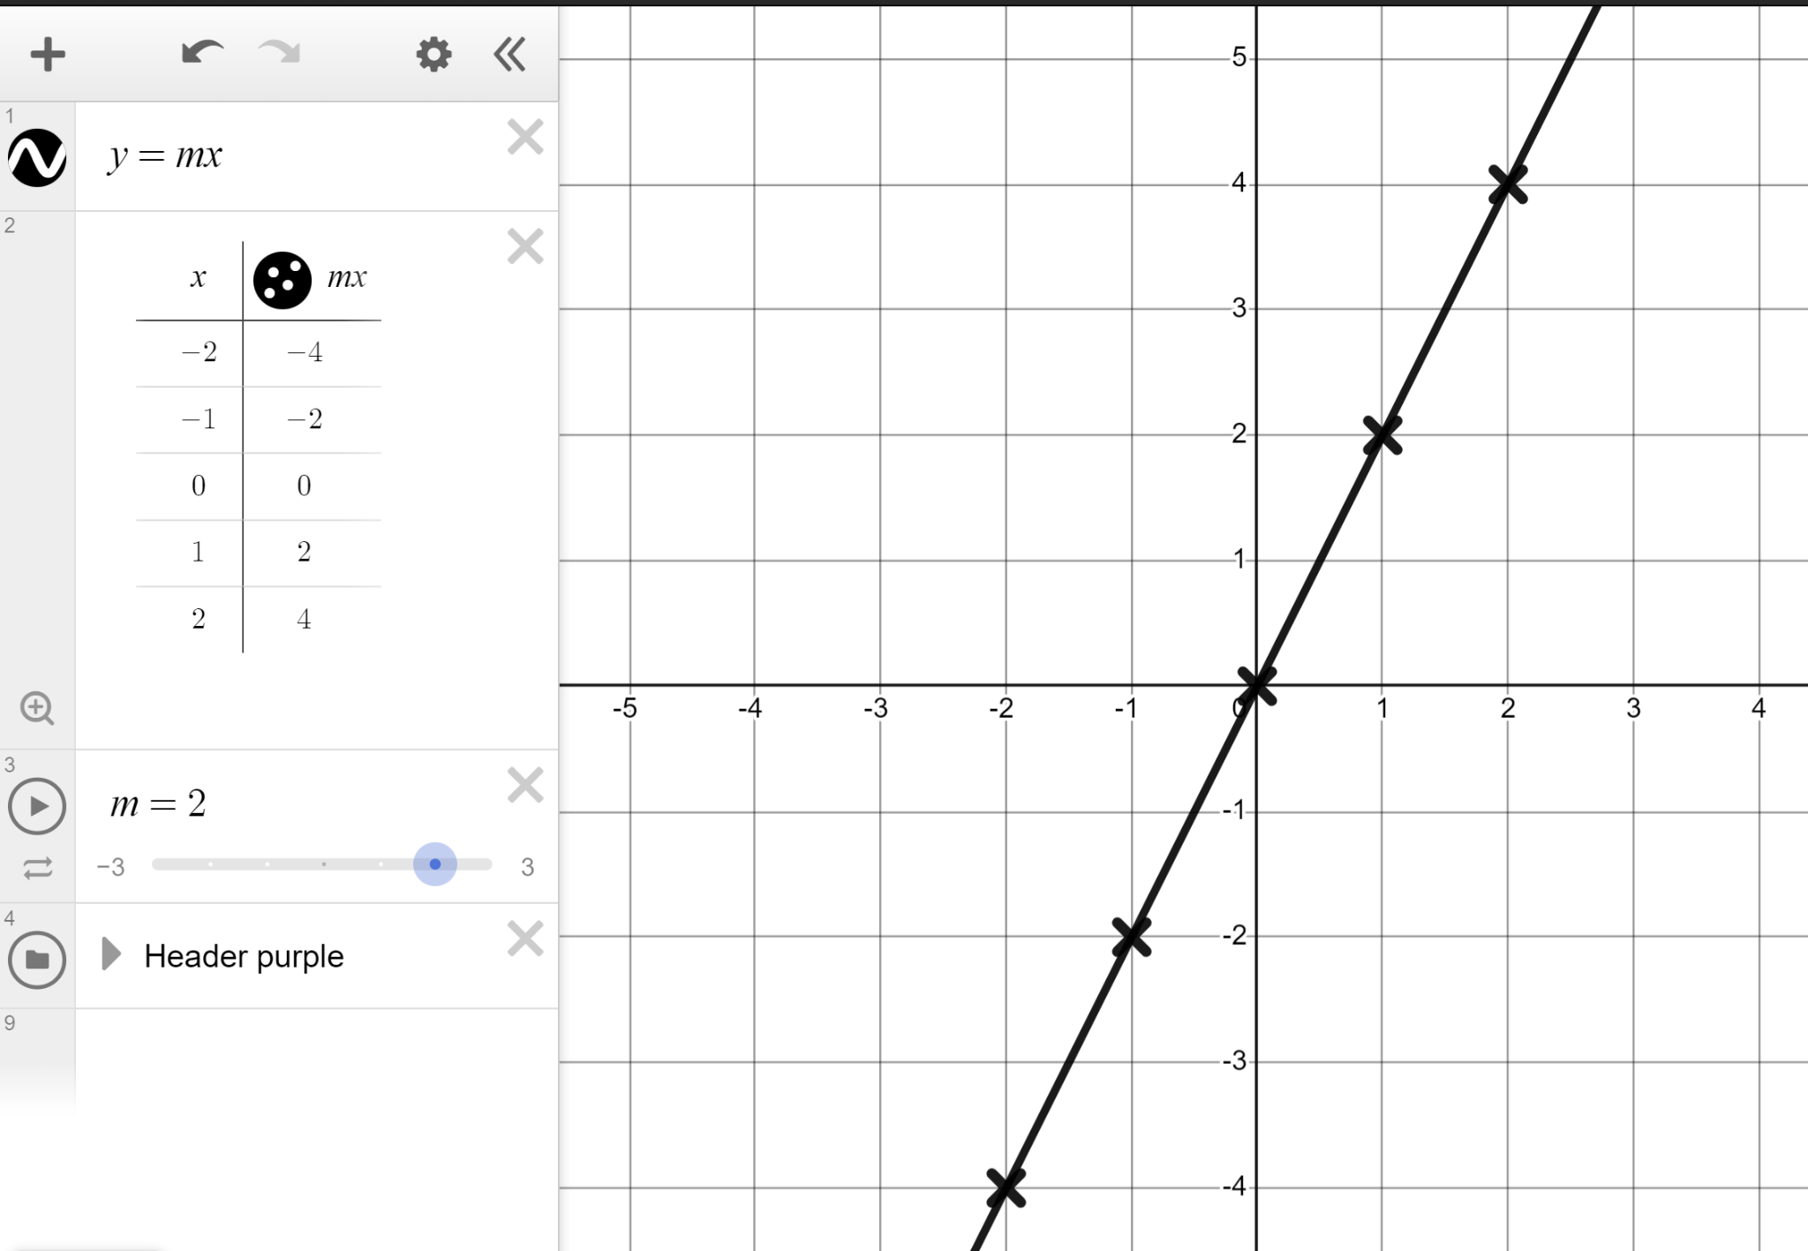
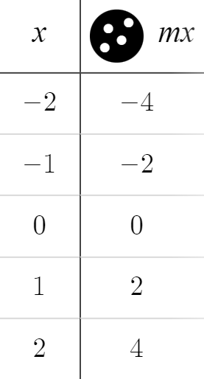

Changing the gradient
“The y-coordinate is double the x-coordinate.”
+2
“For every change of +1 in x there is a change of +2 in y”
+1
+2
+2
+1
+2
+2
+1
+2
“A straight line with a gradient of 2”
+2
×2

Slide 16
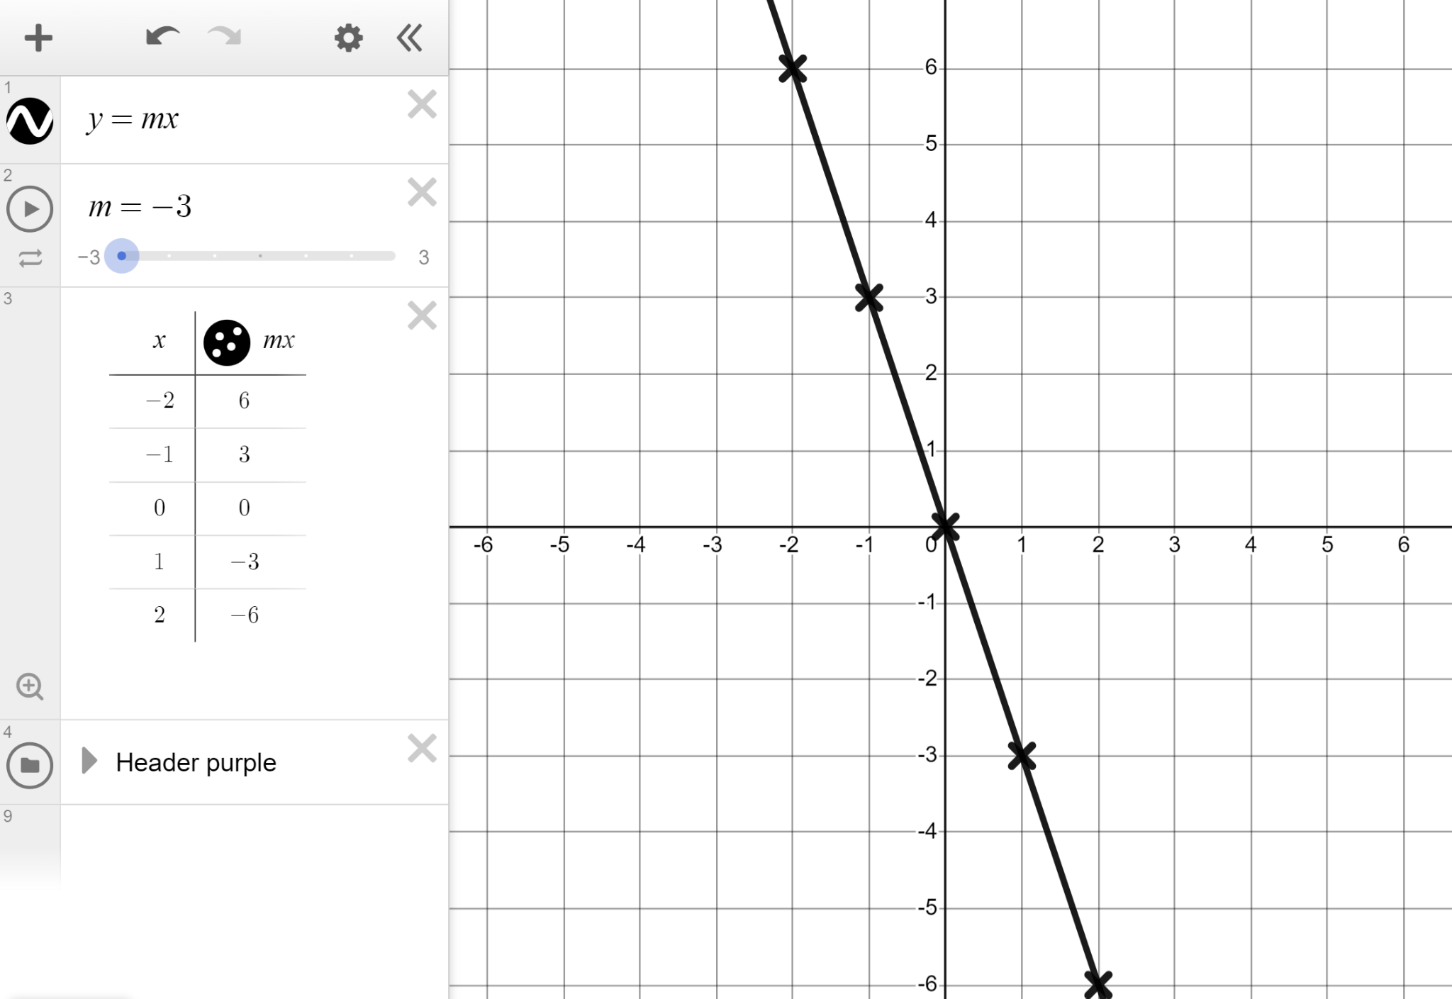
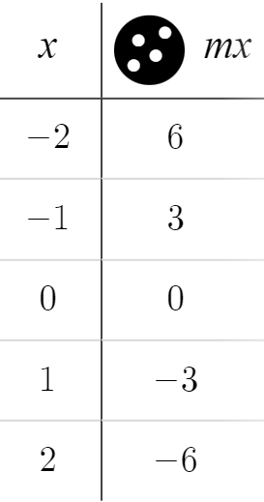
Changing the gradient
Move the slider to draw y = −3x and describe the line.
−3
You might have said:
−3
y-intercept of (0,0)
+1
−3
Gradient of −3
−3
+1
−3
A change of −3 in y for every +1 change in x.
+1
−3
−3
+1
−3
The y coordinate is always −3 times the x-coordinate.
× − 3

Slide 17
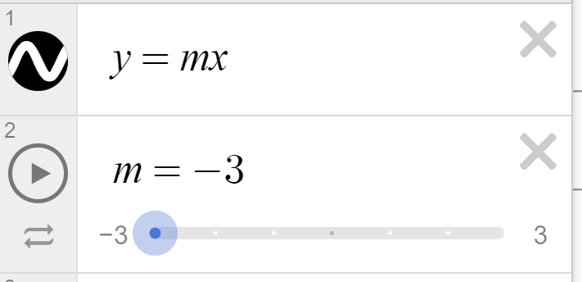
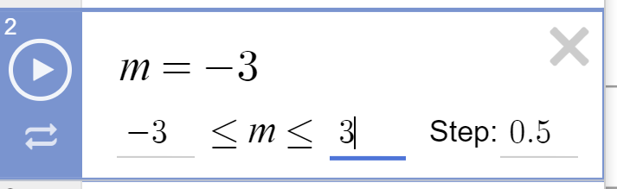
Changing the gradient
We can change the slider to show non-integer gradients.
Click on either the −3 or +3 bounds of your slider.
Change the step to 0.5
Hit ‘play’.

Slide 18
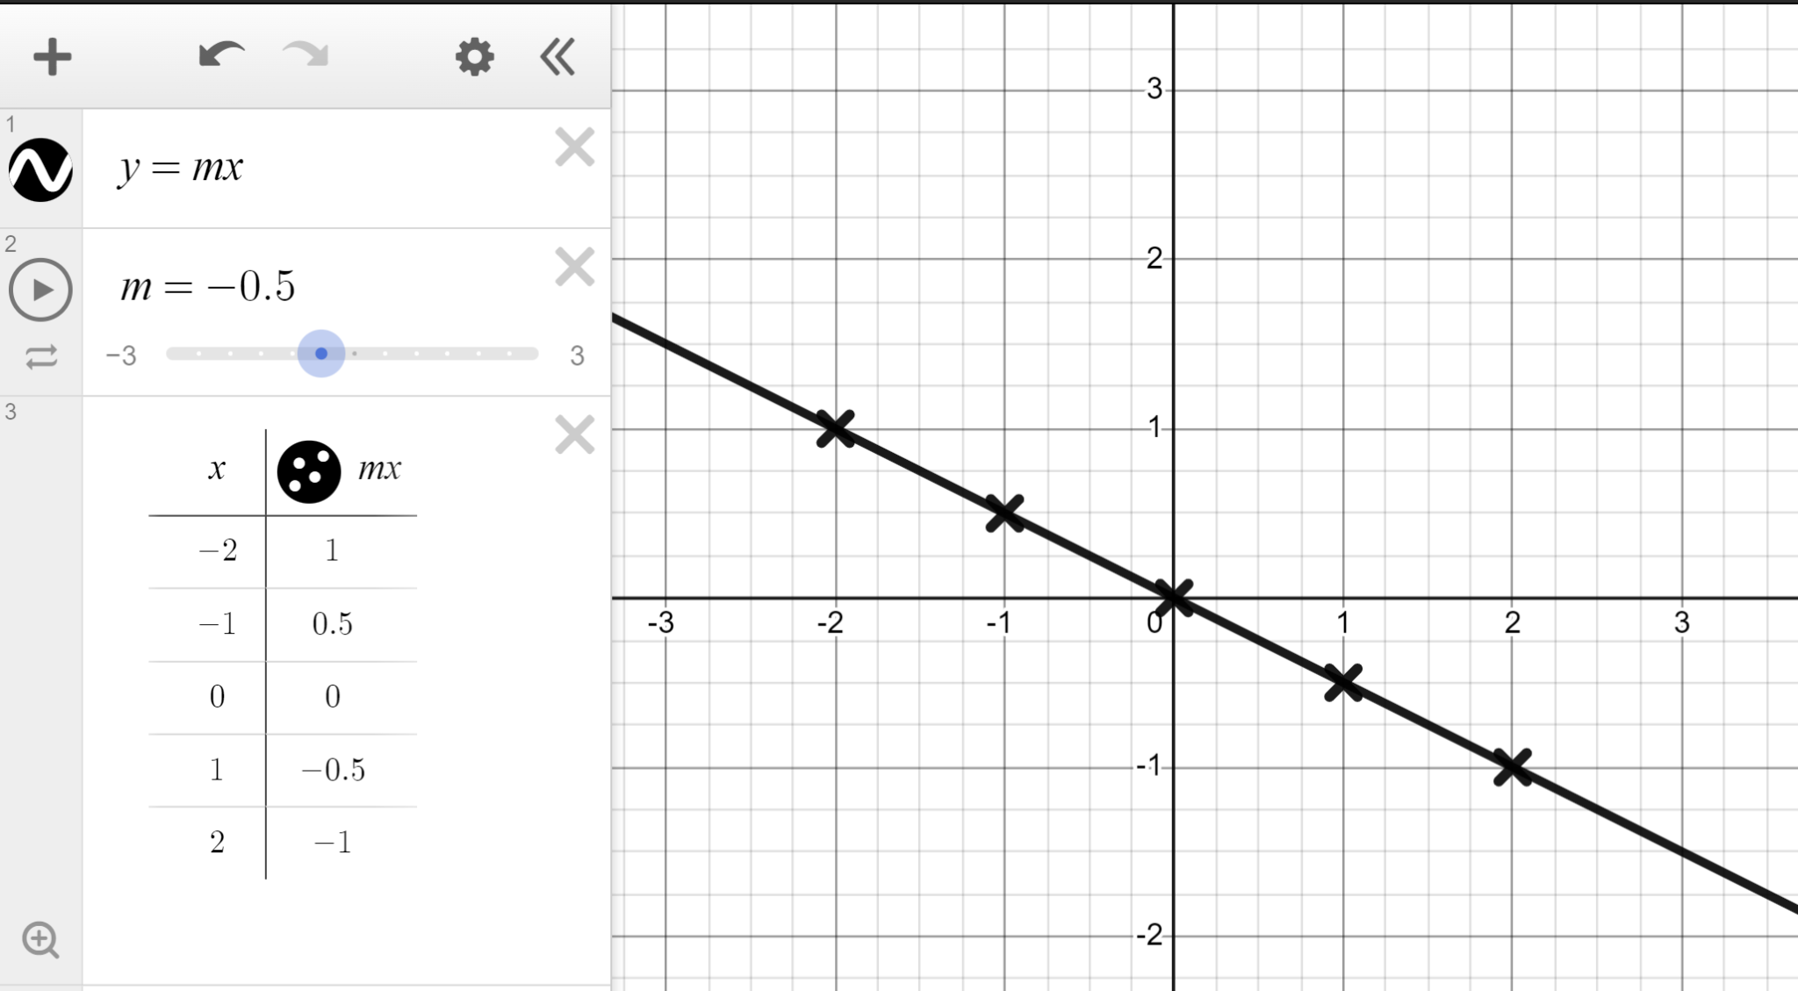
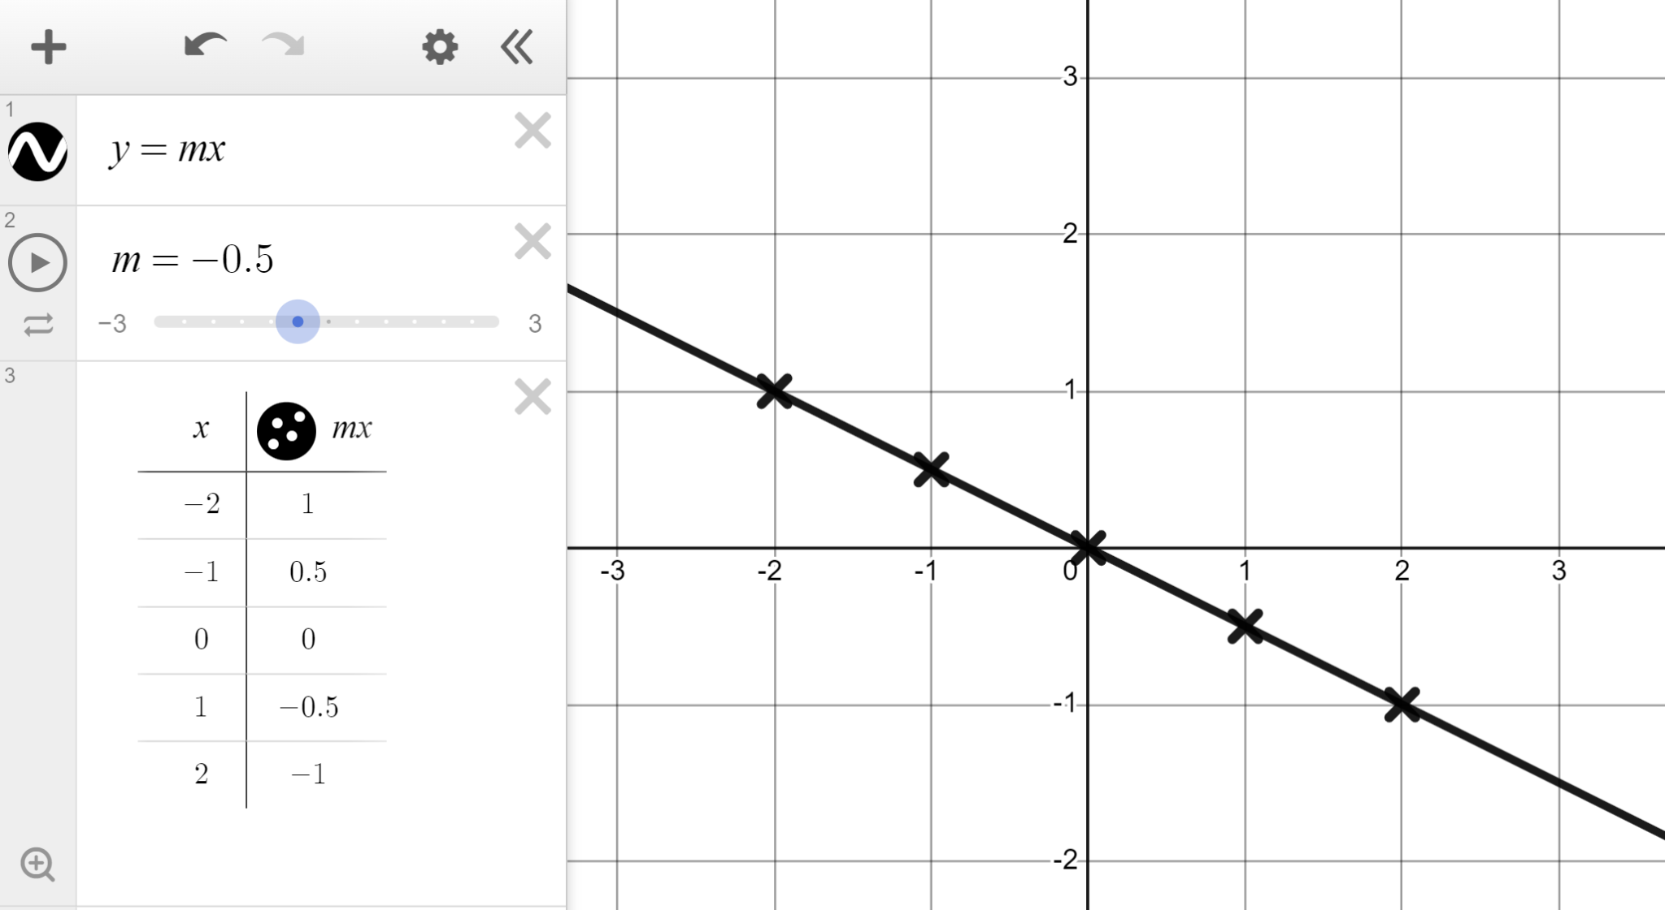
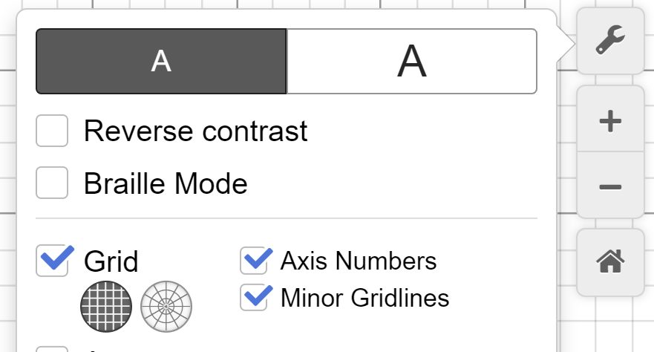
Changing the gradient
You now see these lines.
y = 3x
y = 2.5x
y = 2x
y = 1.5x
y = x
y = 0.5x
y = 0x
y = −0.5x
y = −x
y = −1.5x
y = −2x
y = −2.5x
y = −3x
In the top right click ‘Graph settings’ and turn back on the ‘minor gridlines’.

Slide 19


Changing the gradient
Which of these is true of y = −0.5x ?
gradient of −0.5
−0.5
goes through (0, −0.5)
y-intercept at the origin
change of −0.5 in y for every change of +1 in x

Slide 20



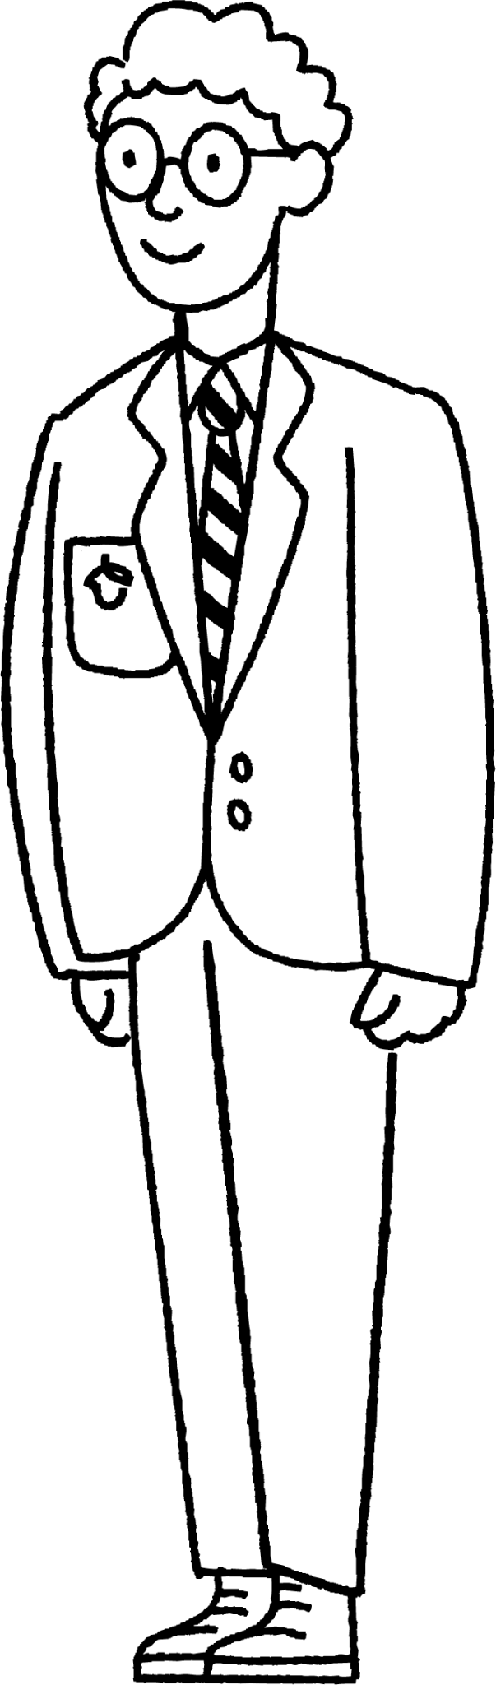
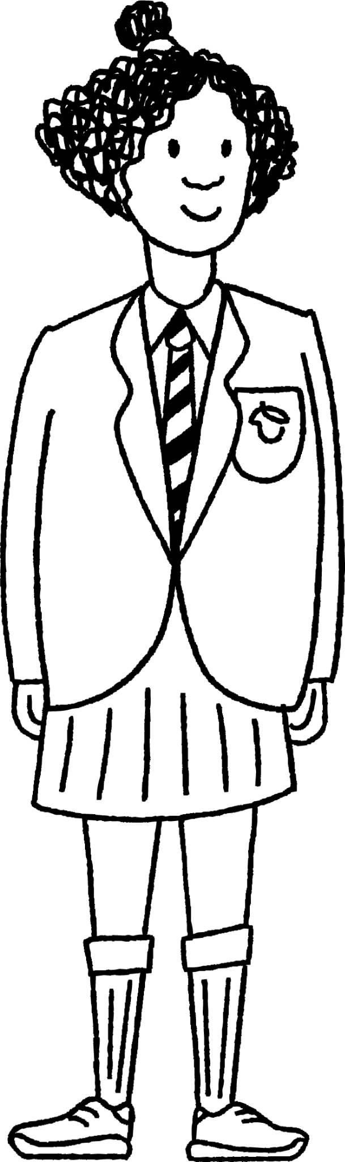





Changing the gradient
Dynamic software should be used to complete this task.
1) You are the teacher.
Plot the line y = 3x, add a table, turn the coordinates into crosses, and explain to the Oak pupils the link between the algebra, the table, and the graph.

Slide 21
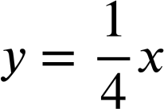
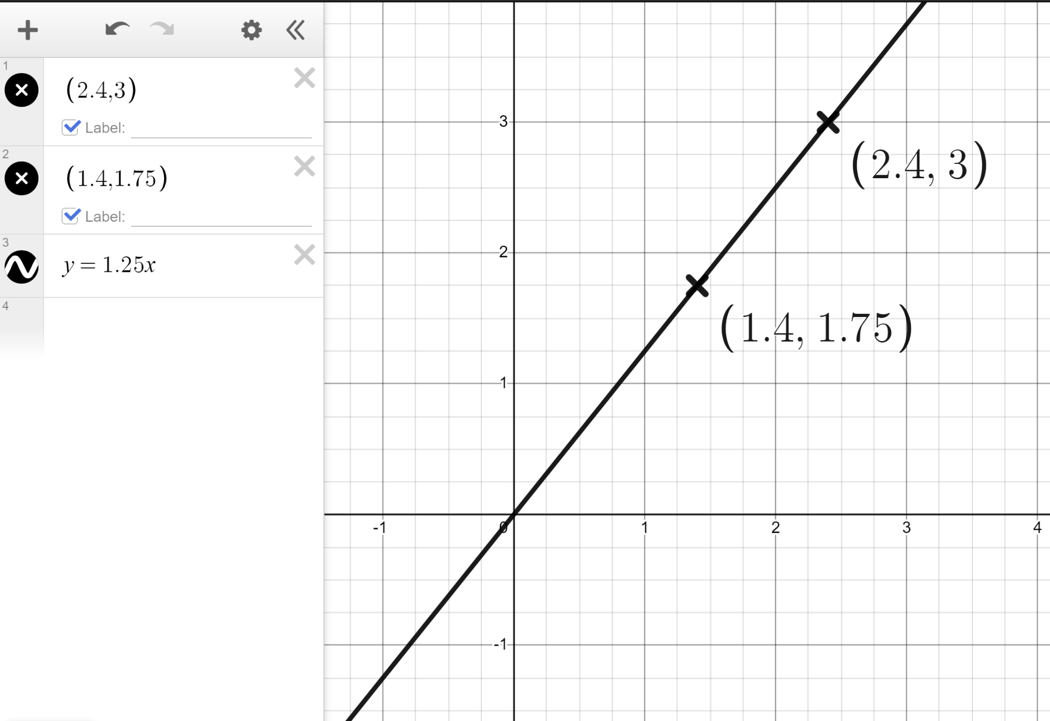
Changing the gradient
2) Plot the lines y = −4x and
Compare the two lines.
3) Plot the coordinates (2.4, 3) and (1.4, 1.75) and draw the straight line that goes through both and the origin.
What is this line?

Slide 22
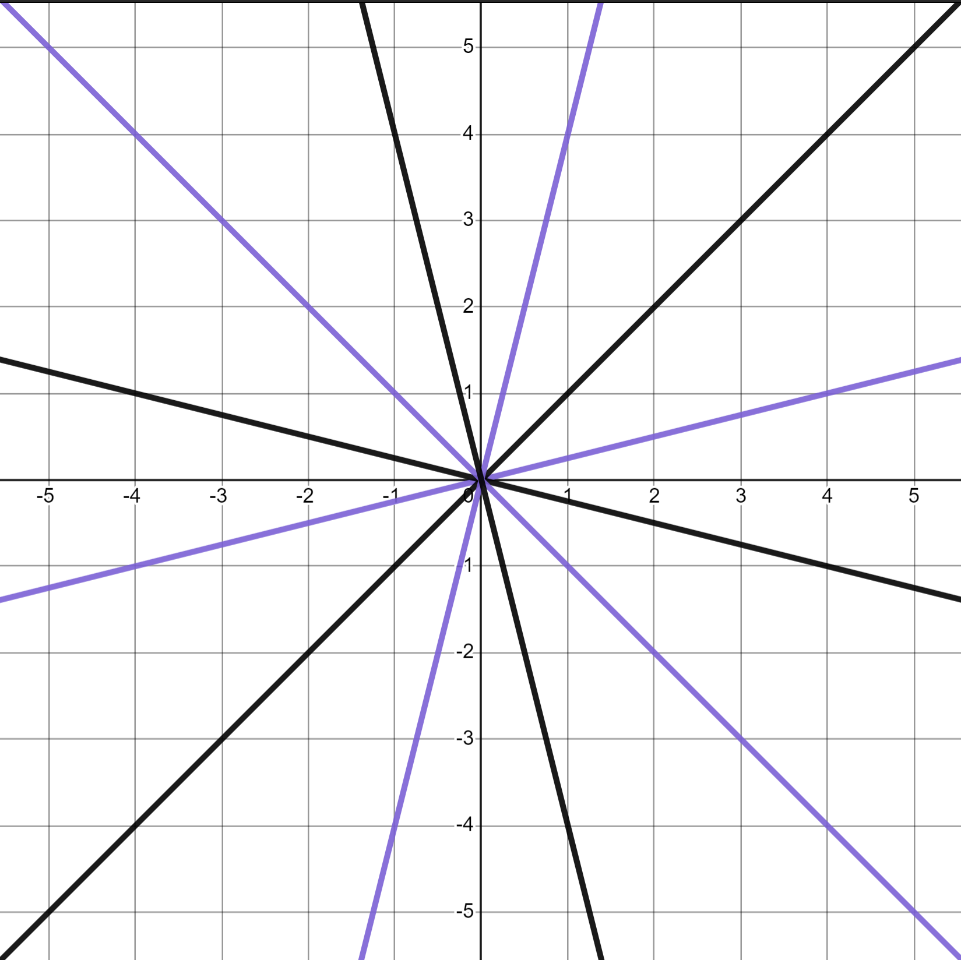
Changing the gradient
4) Draw the lines that recreate this pattern.

Slide 23
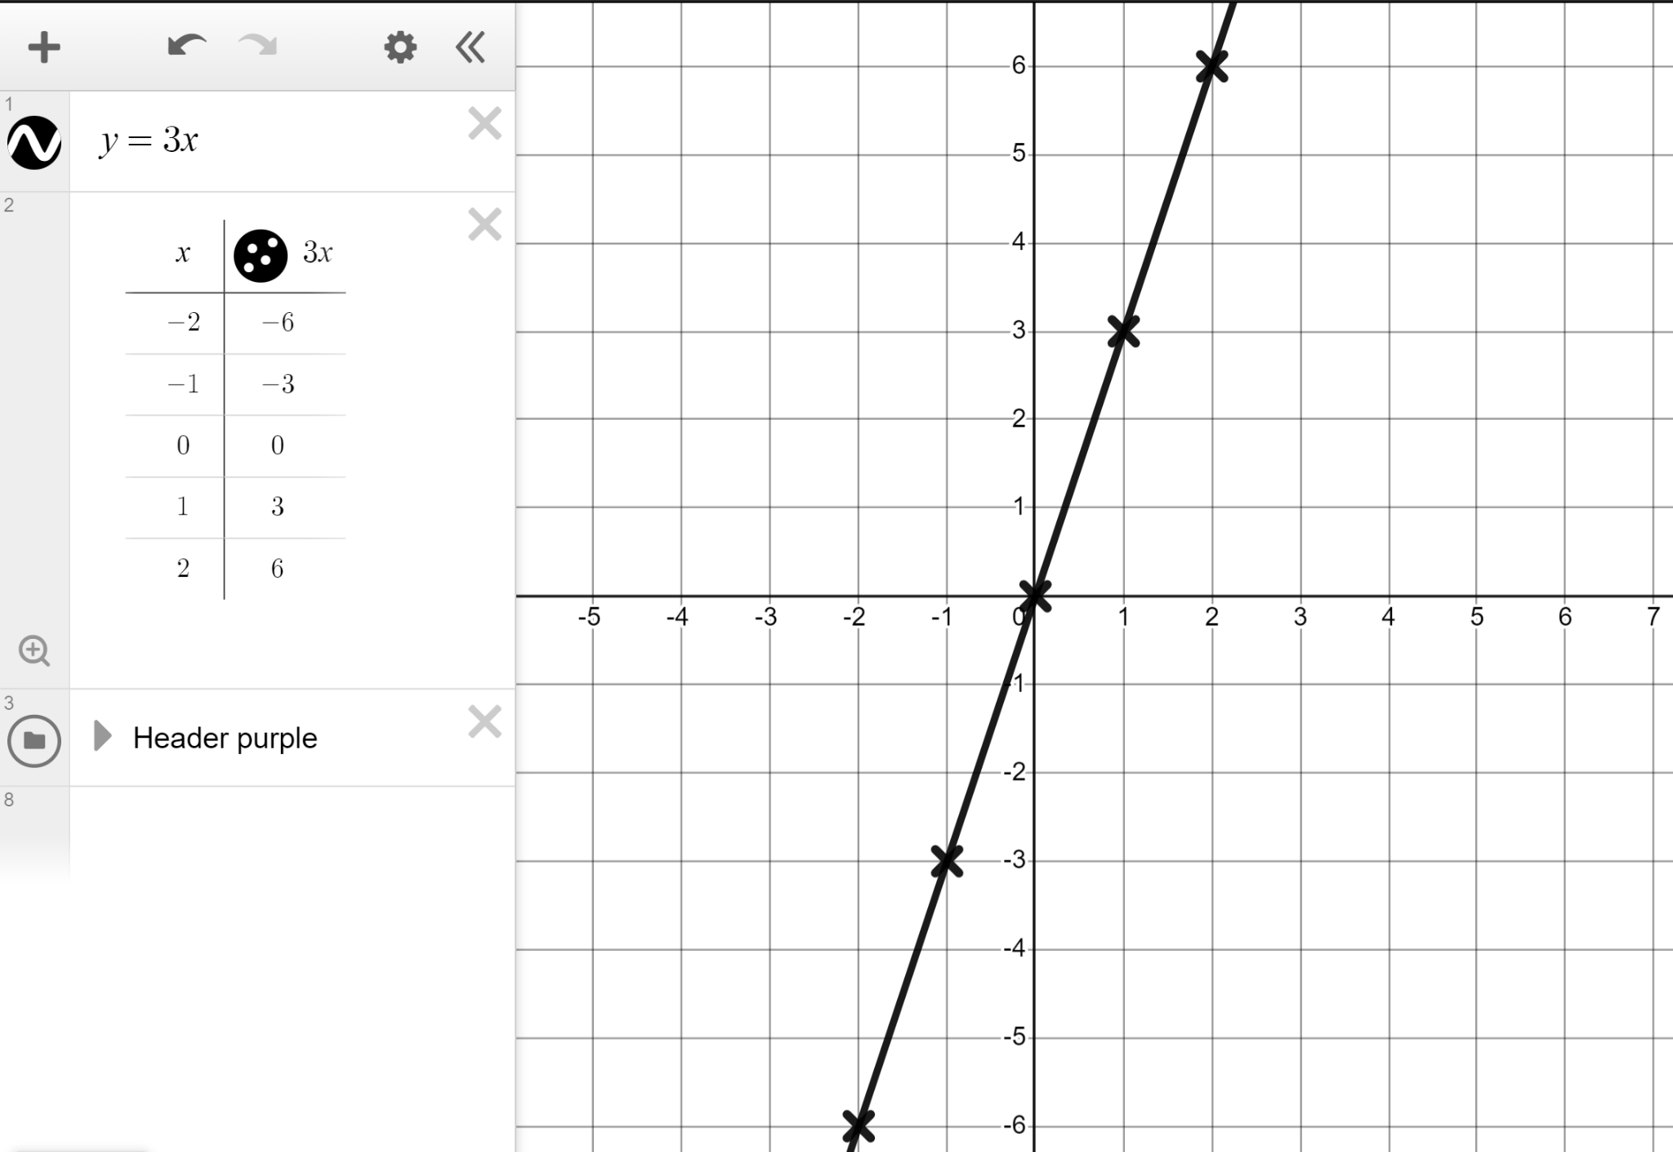
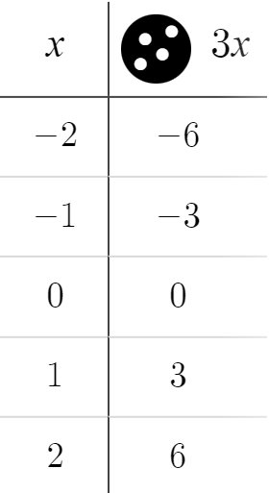
Changing the gradient
1) You are the teacher.
Plot the line y = 3x and explain to our Oak pupils the link between the algebra, the table, and the graph.
You may have said:
The algebra (y = 3x) tells us that the y coordinate is 3 times the x coordinate; the table and coordinates reflect that.
In y = mx the m represents the gradient. For y = 3x we see the gradient of 3 on the graph and a change of +3 in y for every +1 change in x in the table.

Slide 24
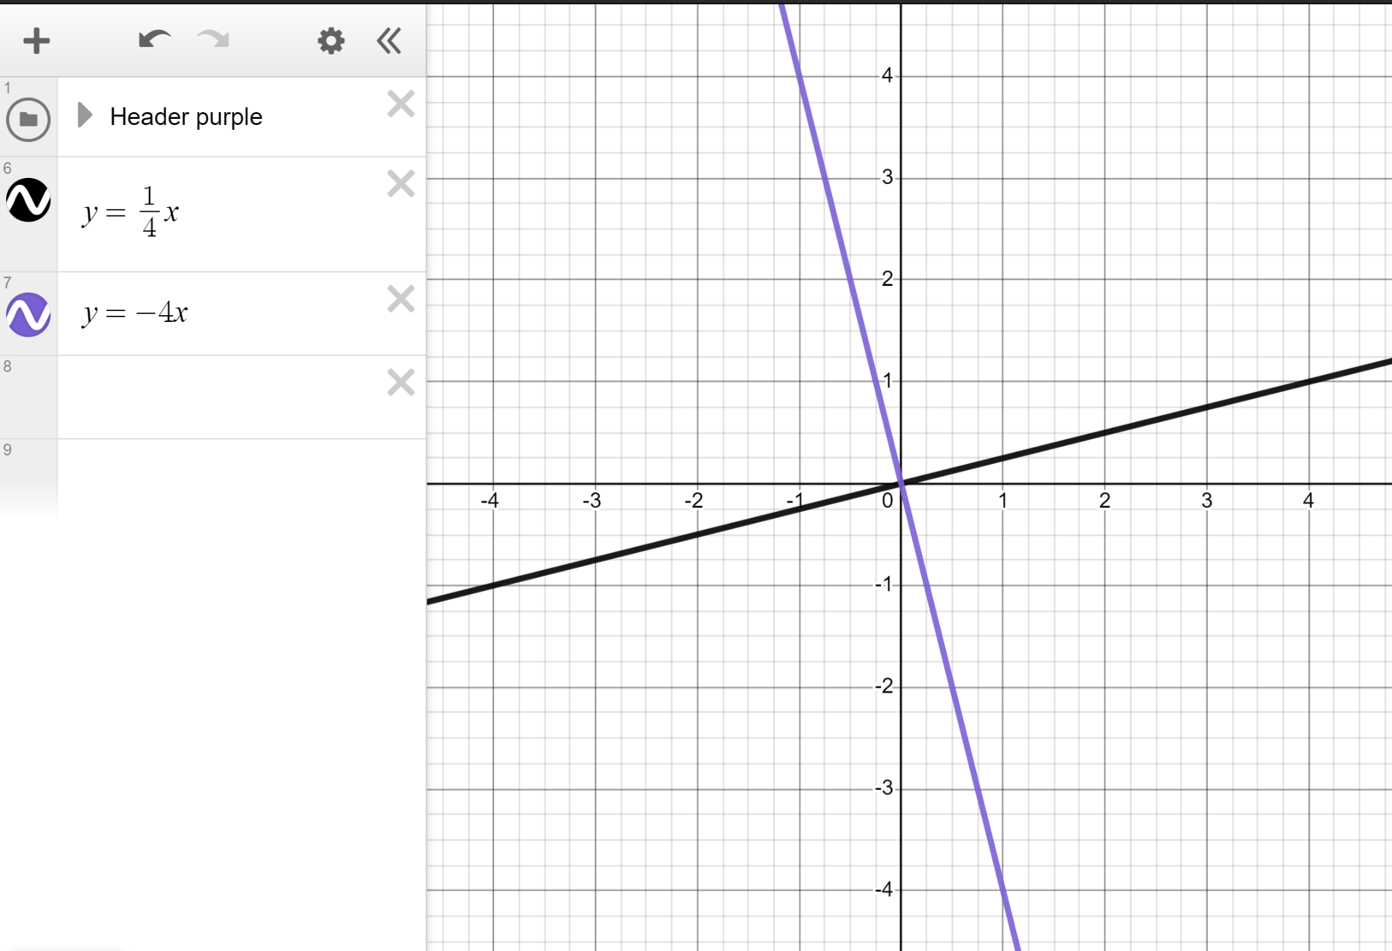

Changing the gradient
2) Plot the lines y = −4x and
Compare the two lines.
You may have said:
Same y-intercept of (0,0)
One has a positive gradient, one a negative gradient.
Respective gradients of −4 and

Slide 25
Changing the gradient
3) Plot the coordinates (2.4, 3) and (1.4, 1.75) and draw the straight line that goes through both and the origin. What is this line?
Between the coordinates you see a change of +1 in x and +1.25 change in y telling us there is a gradient of +1.25
Lines in the form of y = mx go through the origin.
With a gradient of +1.25 this must therefore be the line y = 1.25x

Slide 26
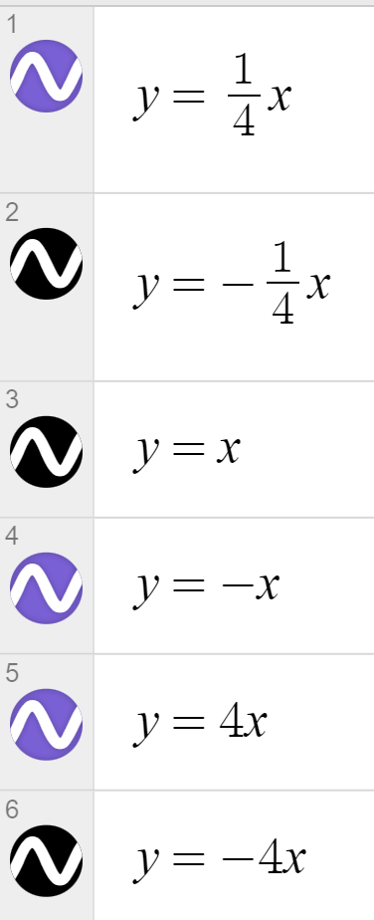
Changing the gradient
4) Draw the lines that recreate this pattern.

Slide 27
Using dynamic software to explore linear relationships
Changing the gradient
Changing the y-intercept

Slide 28
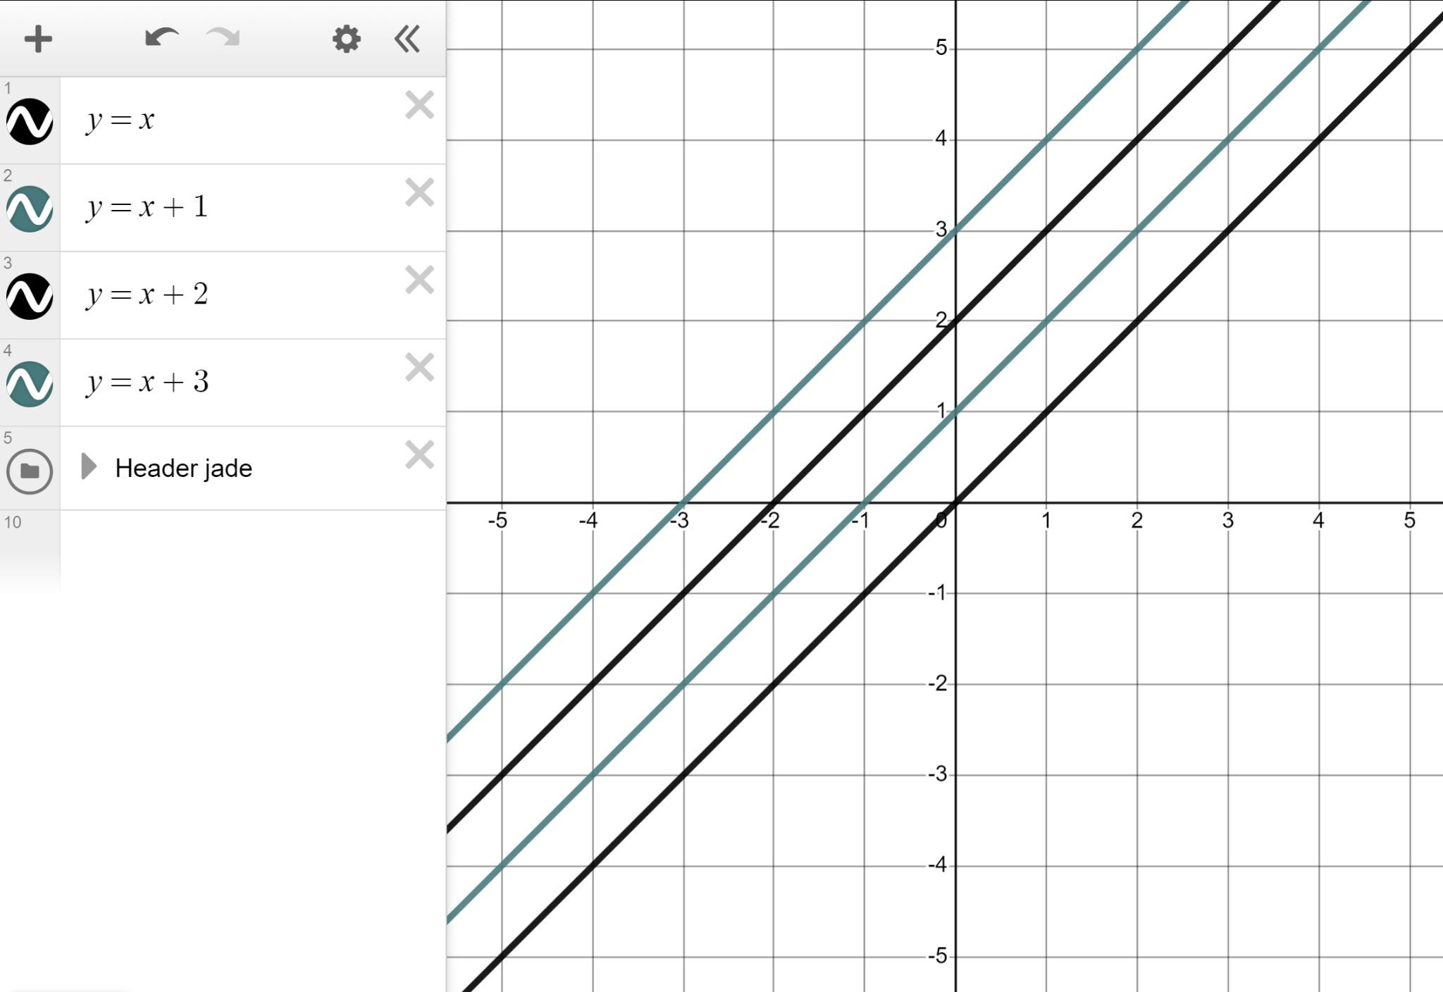
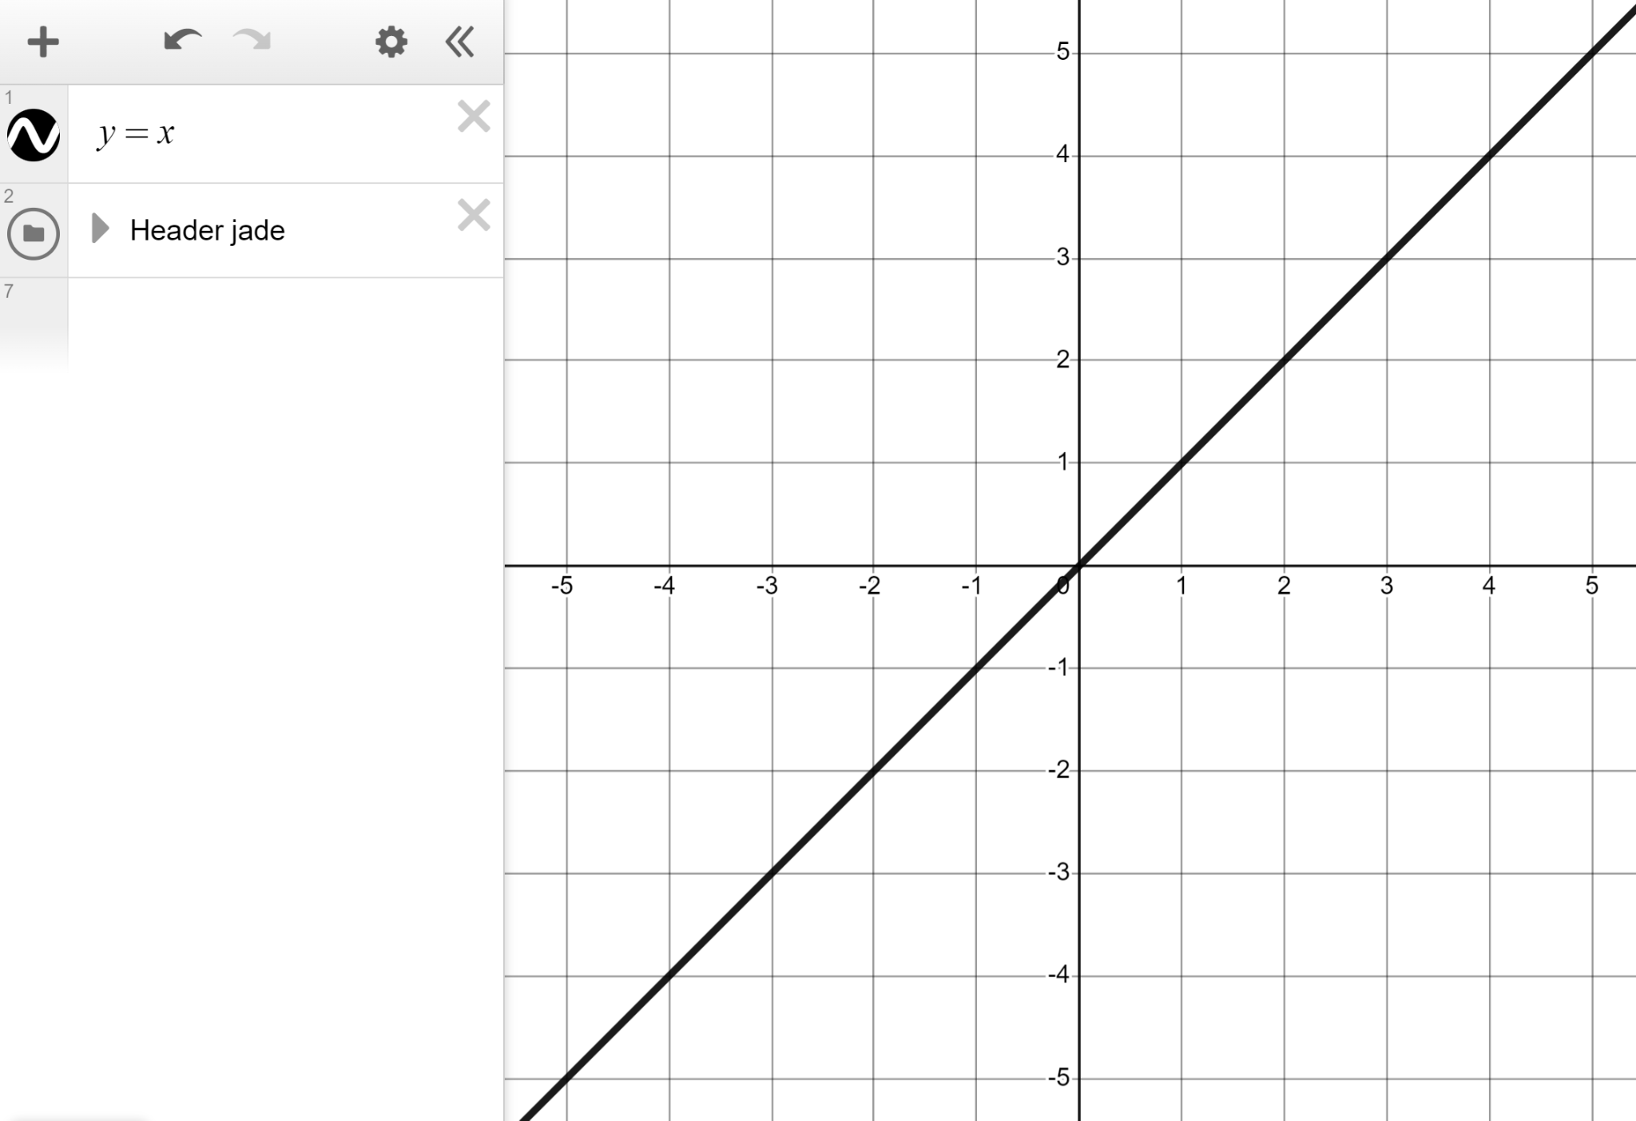
Changing the y-intercept
Every line we have seen so far has gone through the origin (0, 0), for example y = x
Add these lines to this graph. What do you notice?
y = x + 1
y = x + 2
y = x + 3
Same gradient (parallel), different y- and x-intercepts.

Slide 29
Changing the y-intercept
We can use a slider and a coordinate to study what happens when we change the value of c.

Slide 30
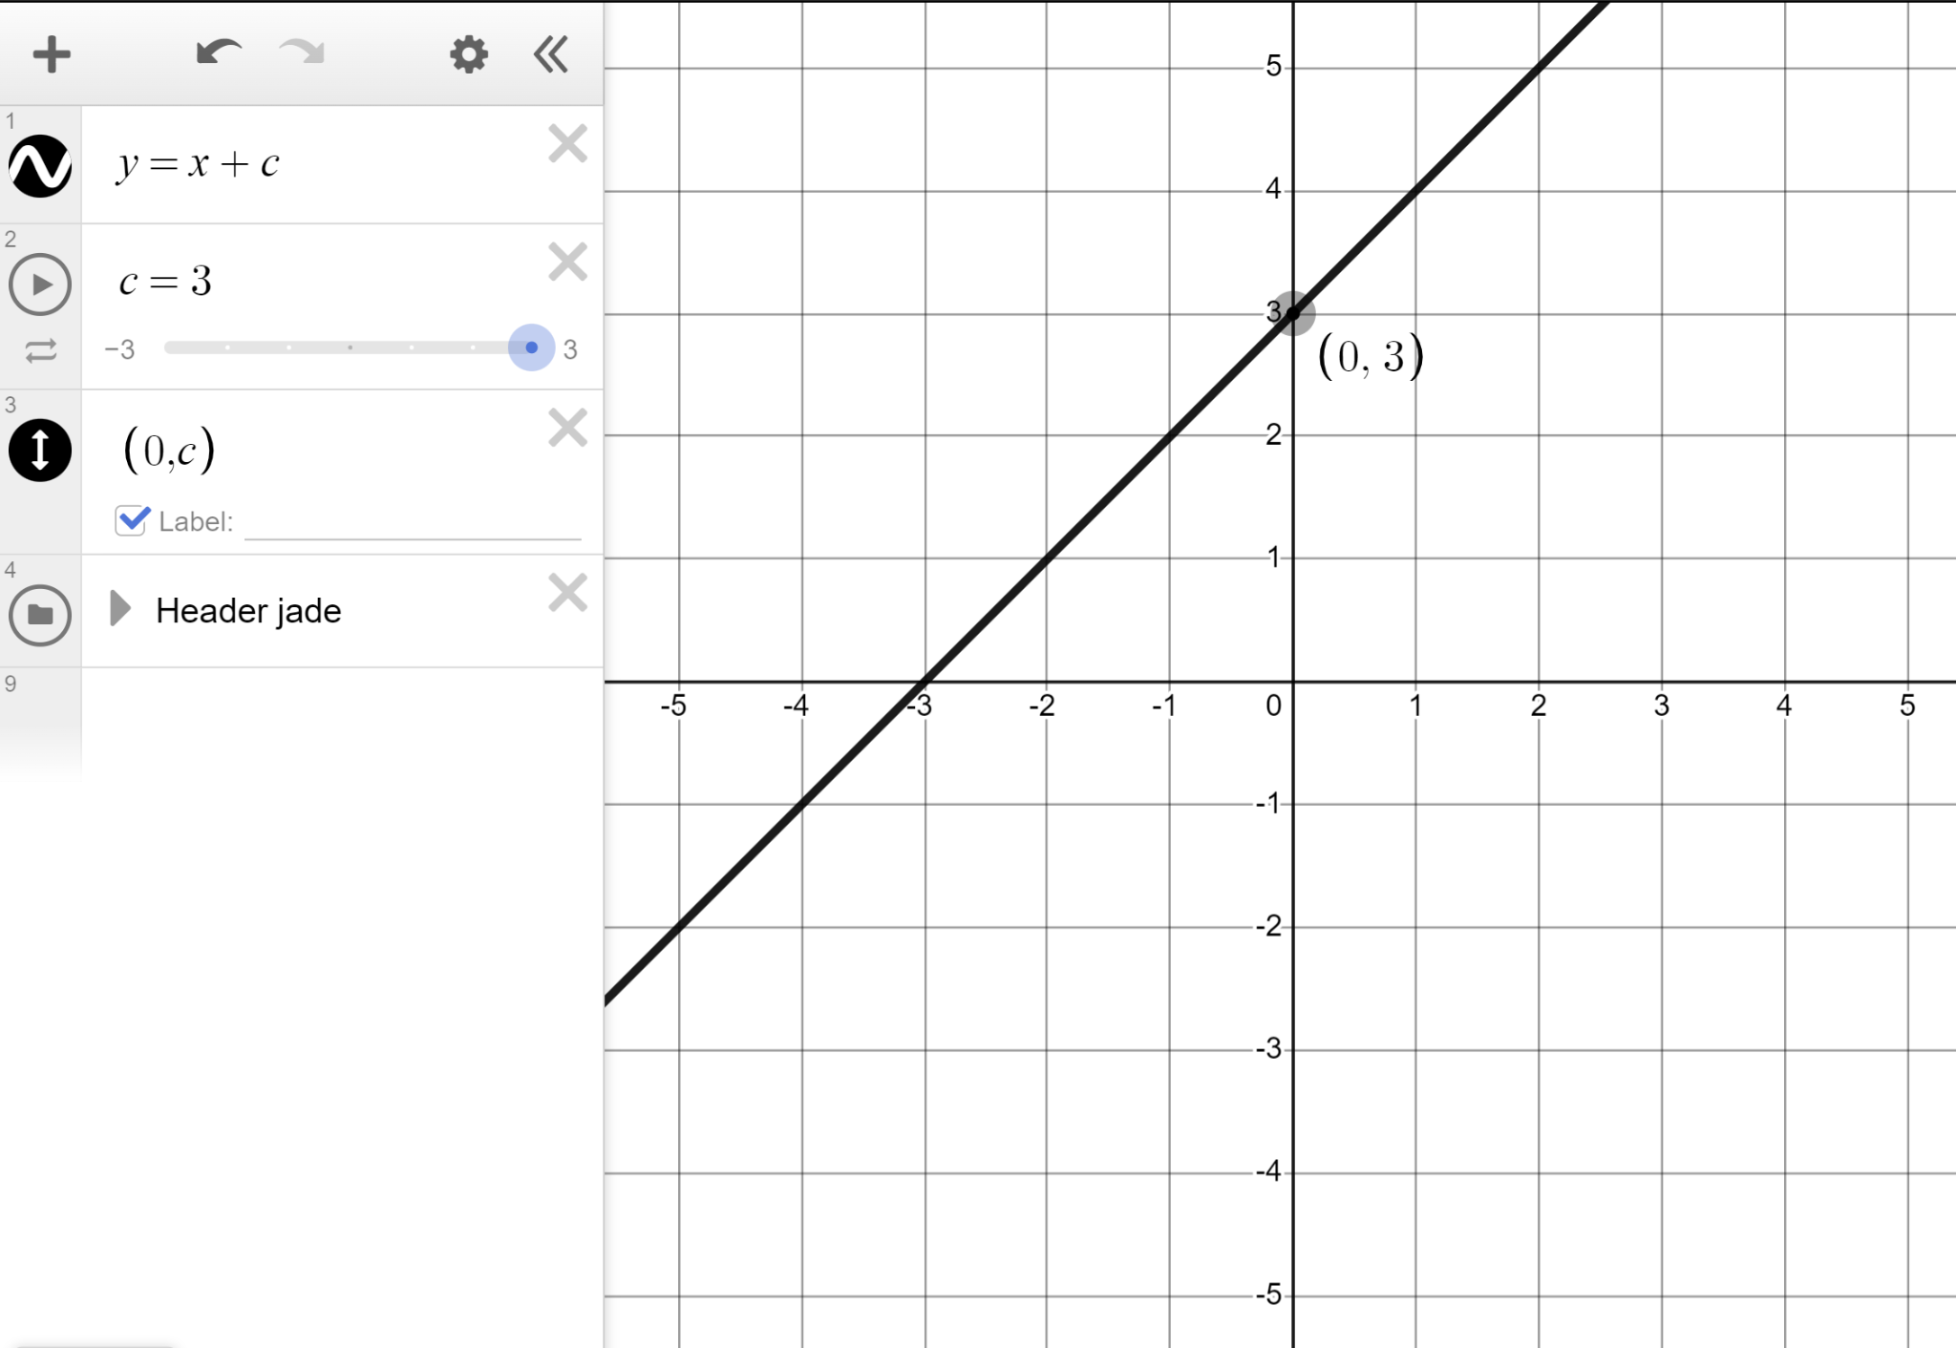
Changing the y-intercept
You now see this.
Line | y-intercept
y = x + c | (0, c)
y = x + 3 | (0, 3)
y = x + 2 | (0, 2)
y = x + 1 | (0, 1)
y = x | (0, 0)
y = x − 1 | (0, −1)
y = x − 2 | (0, −2)
y = x − 3 | (0, −3)
Line | y-intercept
y = x + 3 | (0, 3)
y = x + 2 | (0, 2)
y = x + 1 | (0, 1)
y = x | (0, 0)
y = x − 1 | (0, −1)
y = x − 2 | (0, −2)
y = x − 3 | (0, −3)
c determines our y-intercept.

Slide 31
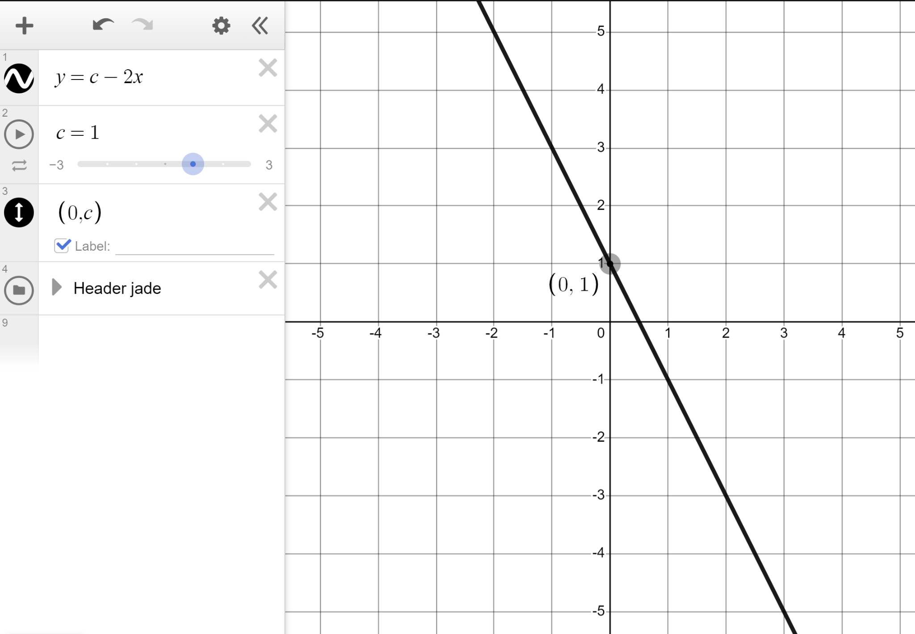
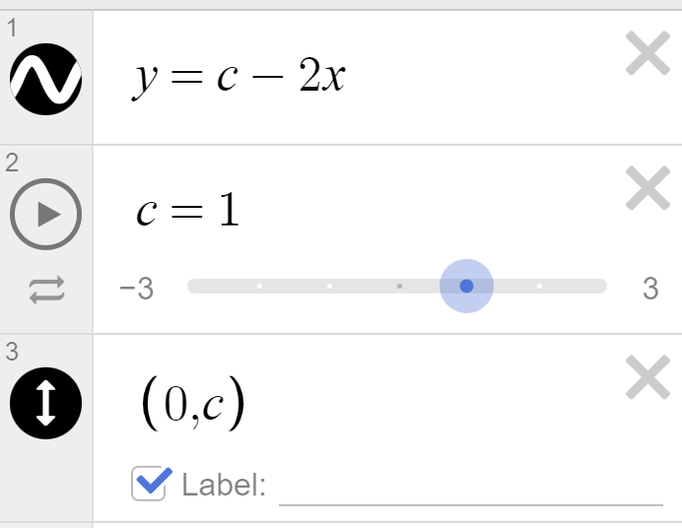
Changing the y-intercept
Set your desmos up to plot the line y = c − 2x
c should be set up as a slider with steps of 1
Hit ‘play’.
What do you notice?
y = 3 − 2x
y = 2 − 2x
y = 1 − 2x … had the same gradient of −2 (parallel lines)
and respective y-intercepts of (0, 3), (0, 2), (0, 1) ...

Slide 32
Changing the y-intercept
Fill in the missing values in the table.
Line | y-intercept
y = c − 2x | (0, c)
y = 3 − 2x | (0, 3)
 | (0, 2)
y = 1 − 2x
y = 0 − 2x | (0, 0)
y = −1 − 2x
y = −2 − 2x | (0, −2)
 | (0, −3)
y = 2 − 2x
(0, 1)
(0, −1)
y = −3 − 2x

Slide 33
Changing the y-intercept
In lines in the form y = mx + c the m determines the gradient whereas the c determines the .
x-intercept
y-intercept
the y-axis

Slide 34
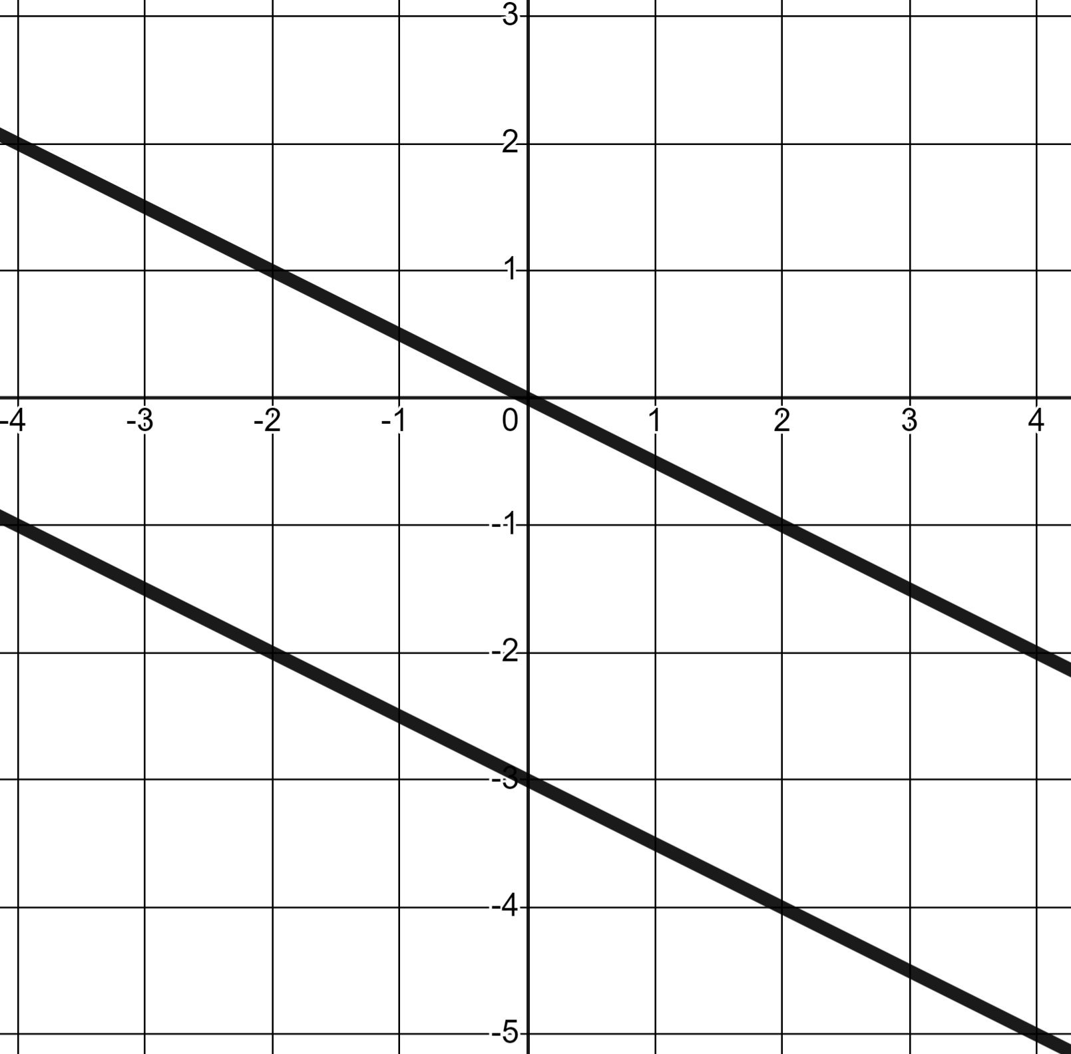
Changing the y-intercept
If the line through the origin is y = −0.5x what is the second line?
y = 3 − 0.5x
y = −0.5x − 3
Same gradient −0.5, y-intercept (0, −3)
y = −3 − 3x

Slide 35
Changing the y-intercept
Dynamic software should be used to complete this task.
1) Plot the lines and write a sentence or two comparing them.
y = 2x
y = 2x + 3
y = 2x − 4

Slide 36
Changing the y-intercept
2) Plot the lines and complete the table.
Line | Gradient | y-intercept
y = 3x + 7 |  | (0, 7)
y = 3x − 2
y = 0.2x + 2
 | 7 | (0, −3)
 | −3 | (0, 7)

Slide 37
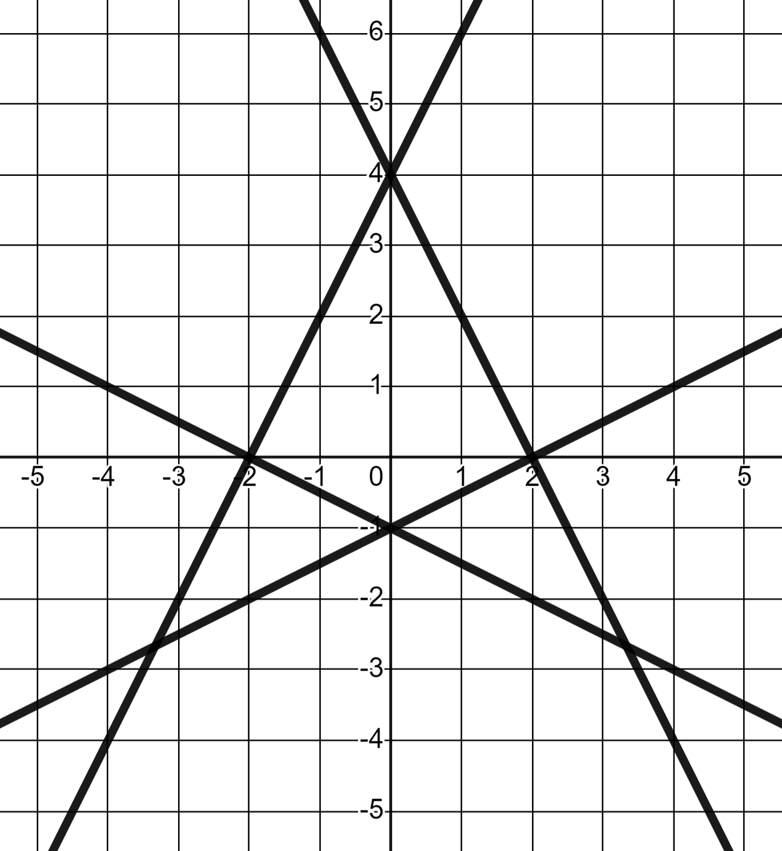
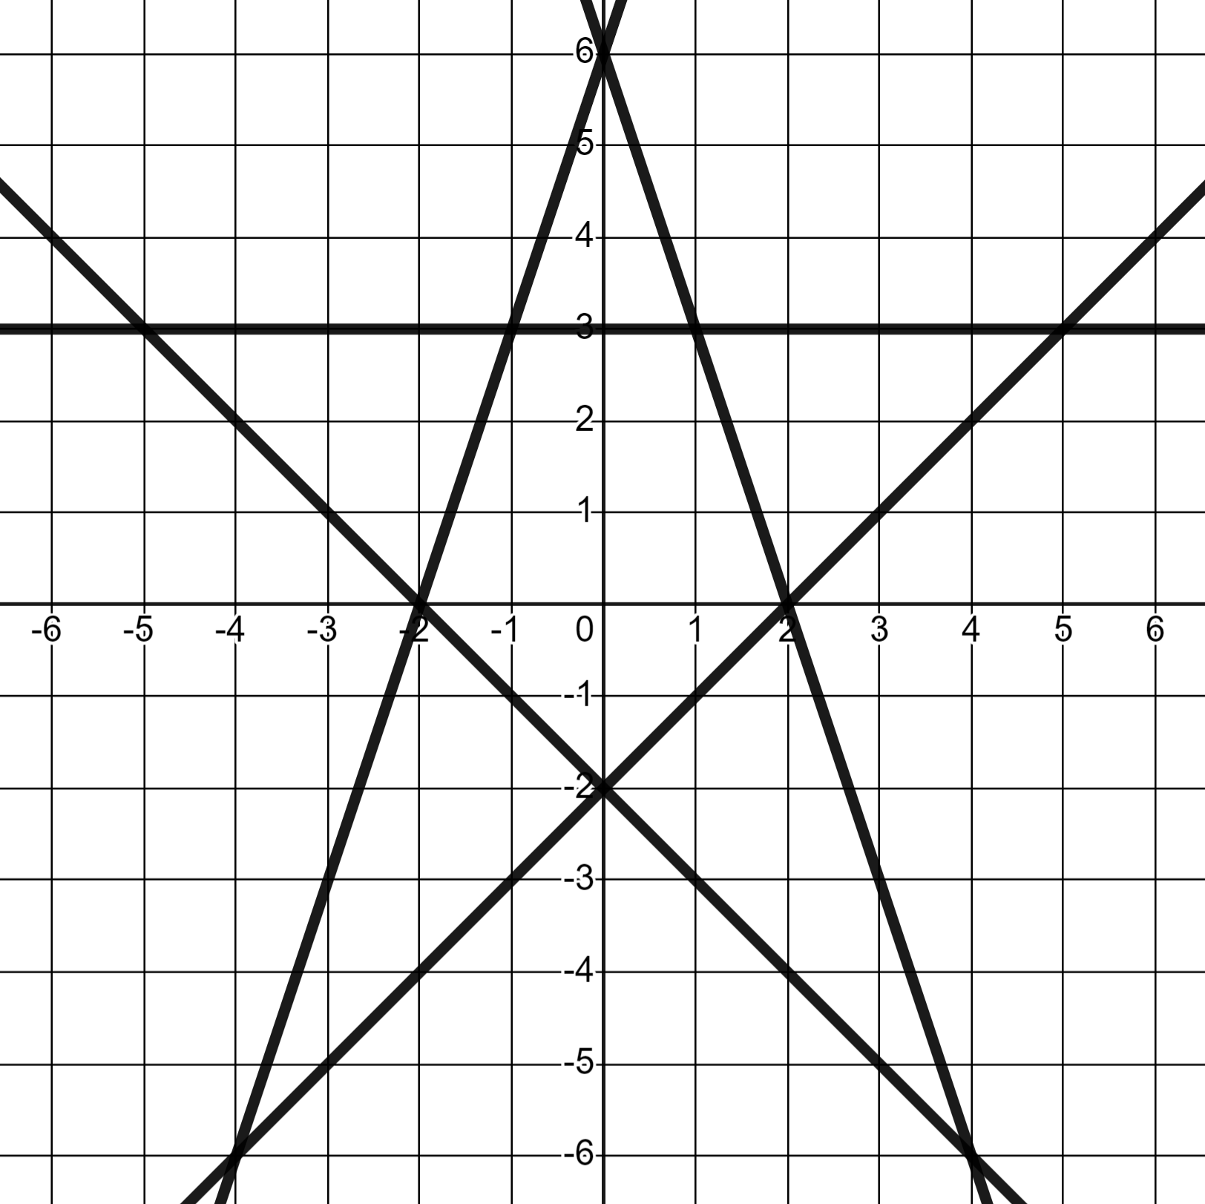
Changing the y-intercept
3) Using Desmos, draw the lines that recreate these patterns.
a)
b)

Slide 38
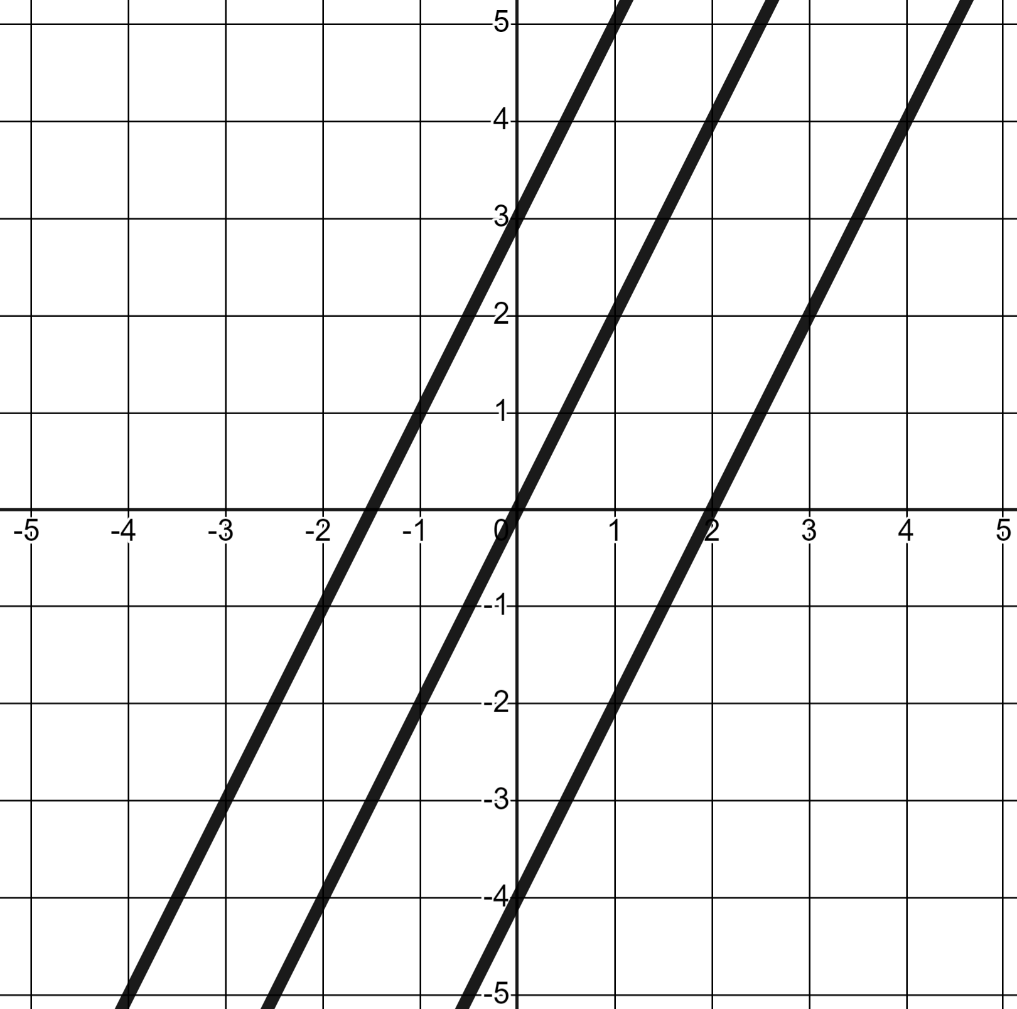
Changing the y-intercept
1) Plot the lines and write a sentence or two comparing them.
y = 2x
y = 2x + 3
y = 2x − 4
All three lines have the same gradient 2 (making them parallel)
Translation of y = 2x by +3 in the y-direction. y-intercept of (0, 3)
Translation of y = 2x by −4 in the y-direction. y-intercept of (0, −4)

Slide 39
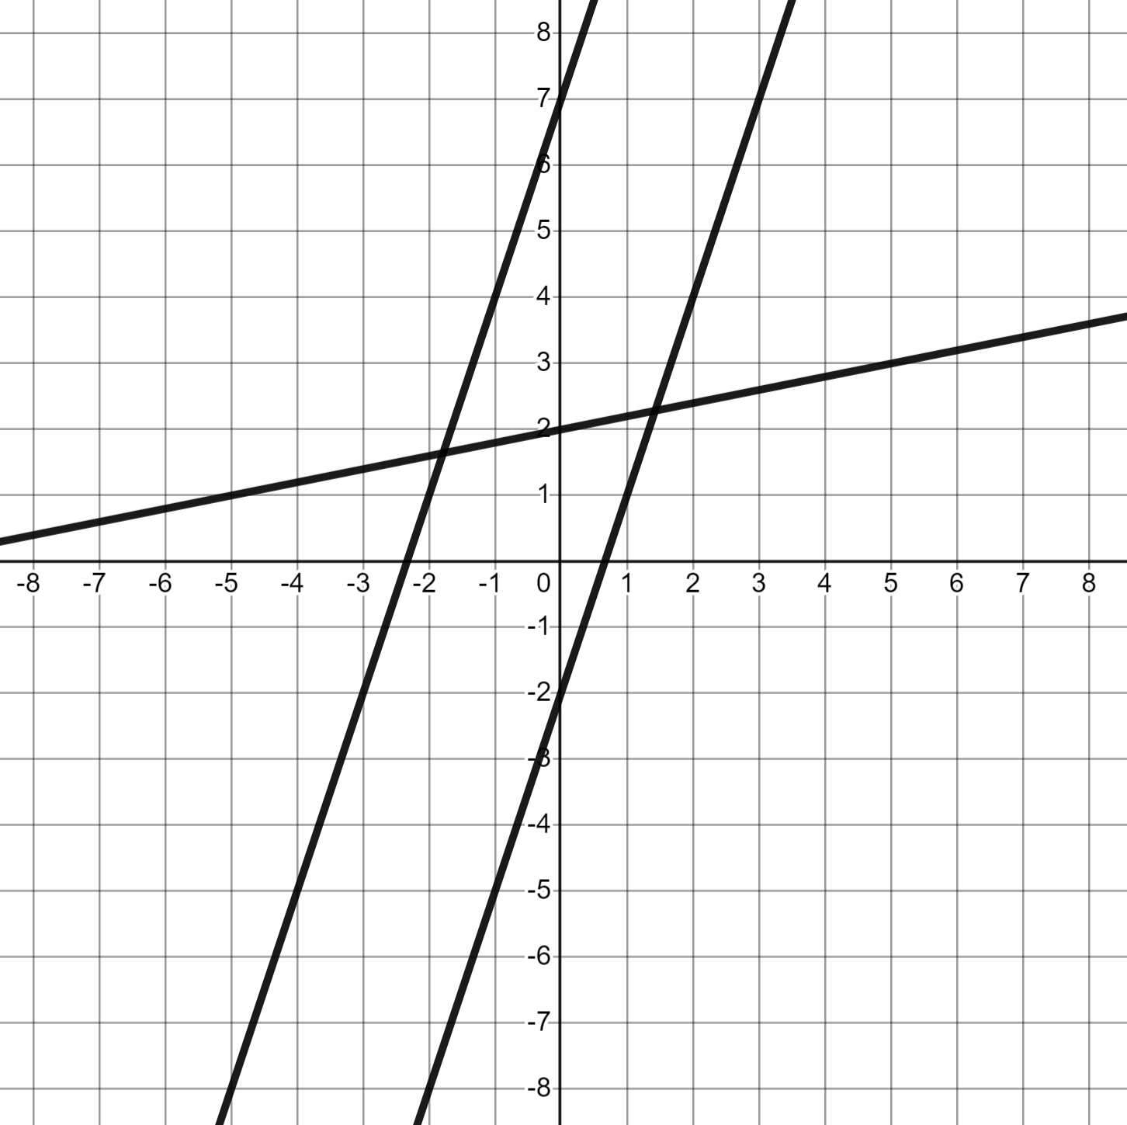
Changing the y-intercept
2) Plot the lines and complete the table.
Line | Gradient | y-intercept
y = 3x + 7 | 3 | (0, 7)
y = 3x − 2 | 3 | (0, −2)
y = 0.2x + 2 | 0.2 | (0, 2)
 | 7 | (0, −3)
 | −3 | (0, 7)

Slide 40
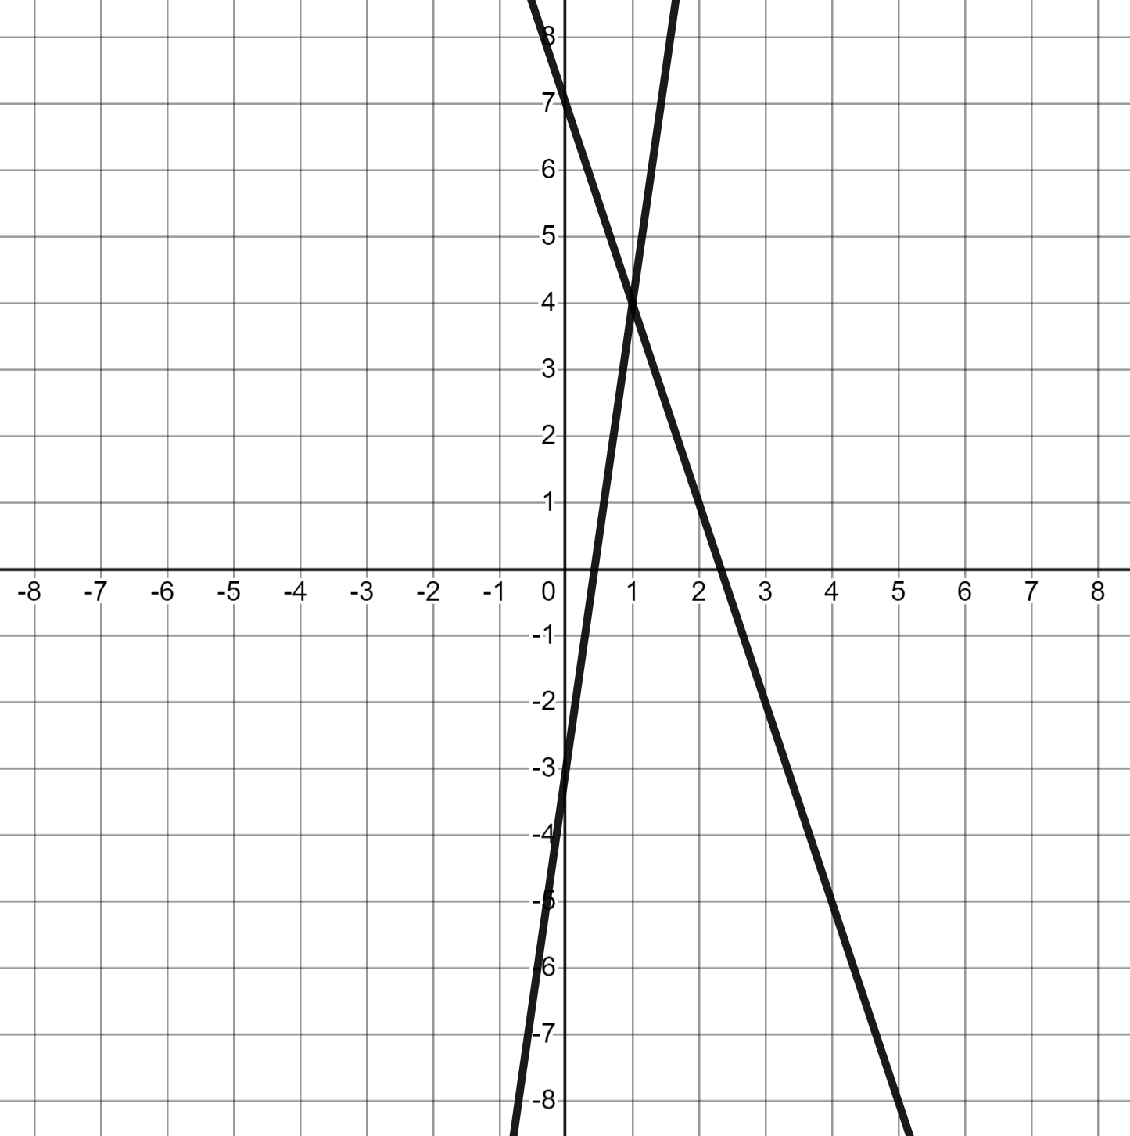
Changing the y-intercept
2) Plot the lines and complete the table.
Line | Gradient | y-intercept
y = 3x + 7 | 3 | (0, 7)
y = 3x − 2 | 3 | (0, −2)
y = 0.2x + 2 | 0.2 | (0, 2)
y = 7x − 3 | 7 | (0, −3)
y = 7 − 3x | −3 | (0, 7)

Slide 41
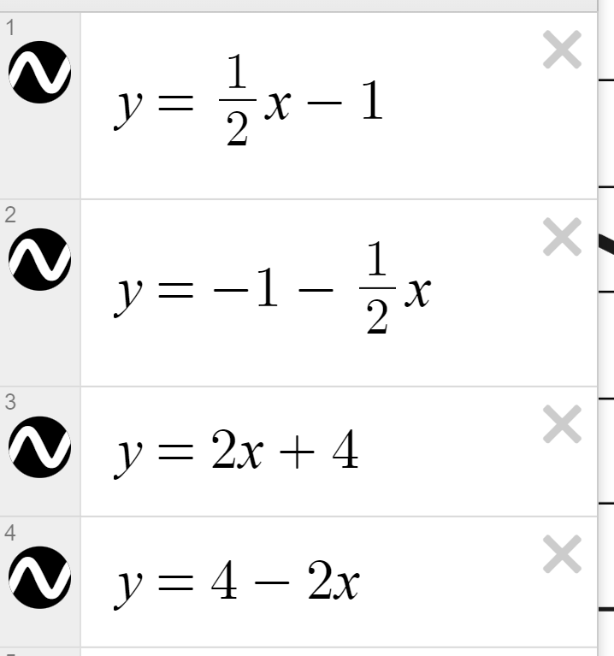
Changing the y-intercept
3) Draw the lines that recreate these patterns.
a)
Two lines of y-intercept (0, 4), two lines of y-intercept (0, −1)

Slide 42
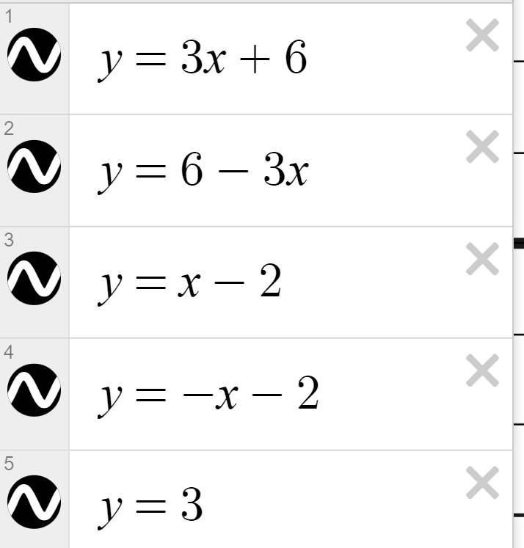
Changing the y-intercept
3) Draw the lines that recreate these patterns.
y-intercepts of (0, 6), (0, 3), and (0, −2)
b)

Slide 43
Using dynamic software to explore linear relationships
Dynamic software can be used to see algebraic and graphical aspects of linear relationships and problem solve with them.
Dynamic software helps us quickly see that in y = mx + c it is the m that determines the gradient and the c that determines the y-intercept.

Slide 44

© Oak National Academy 2023.
Produced in partnership with Mathematics in Education and Industry.
Licensed on the Open Government Licence v3.0, except where otherwise stated. See Oak terms and conditions.

